Slide 1
St Andrews Lutheran College
An inquiry into Positive Organisation
and Positive Education
www.PESA.edu.au © PESA 2018
Notes:
James
Welcome
Story we will tell
Process we will initiate with you
Hopes for future connection

Slide 2
Timeline
2012 Resilience and Positive Psychology
2013 Training
2014 Inquiry & Literacy
2015 – 2016 Living, Teaching & Embedding
2017 New Staff & New Priorities
www.PESA.edu.au © PESA 2018
Notes:
Tania and James alternate years
Our school’s journey
- insert timeline on this slide
2016 story and how this huge level of grief was exacerbated somewhat by the processes and understandings in place around pp

Slide 3
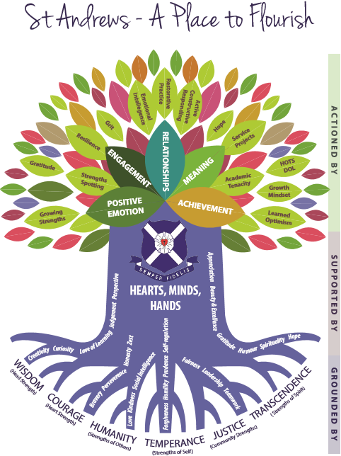
2018 – 2020 strategic Foci…
3 areas in line with Mission
Celebrate the Gospel
Nurture the Individual
Empower Lifelong Learning
www.PESA.edu.au © PESA 2018
Notes:
James
Our school’s journey
- insert priorities going forward to 2020
There’s so much happening – in line with the old Durlak article… but? How can we imagine more? Design more? With which individuals who want to grow more?
Boss has said ‘not new, not change, just better, better, better’
A leadership growth and formation framework called Growing Deep…. Deepening the roots, more fruit on the tree…

Slide 4
Why Positive Psychology and Positive Education?
Mental Health statistics of our young people
Reported impact on wellbeing
Common language for staff to engage with each other and their students
The expectation of the 21st century school
Congruency with our College’s Mission Statement and Strategic Focus 2014-17
The link between student wellbeing and academic performance
www.PESA.edu.au © PESA 2018
Notes:
Tania
Schools are an excellent venue for positive psychology initiatives because:
- Children and adolescents spend so much of their waking time there
- Young people’s relationships with teacher, peers and coaches are integral to their wellbeing
- The promotion of wellbeing and character is seen as a central aspect of schooling.
(Seligman, Ernst, Gillham, Reivich & Linkins, 2009)
From a student perspective 2014 Survey – “It was useful to know some new techniques of facing our studies and our lives. It helped to give insight into my life”.
What was found most useful? Character strengths because they remind that I should use my character strengths to help me be a better student, friend and person

Slide 5
Why a Positive Institution?
21st Century Needs
Educating the whole child - incorporating student wellbeing as well as the traditional academic goals, in the face of increasing levels of depression and mental health (Waters, 2011).
College Strategic Intent 2014-17
Applying positive psychology to the education setting can promote, support and build a positive working environment for staff and students which will then enhance the ability of all within the institution to thrive, flourish or successfully develop.
Personally
I am inspired by the thought that the “opportunity for individuals within the education field to actually achieve the goal that every child succeed to their fullest potential may exist within positive psychology” (Terjesen, Jacofsky, Froh & DiGisueppe, 2004).
Expert Evidence
A Positive Institution is one “that move individuals toward better citizenship, responsibility, nurturance, altruism, civility, moderation, tolerance and work ethic” (Seligman and Cskiszentmihalyi, 2000, p.5).
www.PESA.edu.au © PESA 2018
Notes:
Tania
As stated earlier, it was a shift in thinking and culture.
Away from ‘problem solving mentality around student mental health, ie. Chasing program for Resilience’….
How our students saw it – 2014 survey response from a senior student when asked what pp is “Positive psychology is when you focus on the good things rather than the bad and we are addressing it because it is a useful tool to have throughout your life and can prevent depression”
Positive psychology, to me, is shifting the attitude of students and teachers from being negative towards life and specifically work to positive. Therefore we're addressing it at St Andrews to improve the wellbeing of teachers and students.”
I like taking surveys and finding my character strengths. I find it interesting to see what I'm good at and what I need to improve on. I also like seeing, overall, what kind of person I am.
James - High trust, high investment employer of choice

Slide 6
St Andrews – A Place to Flourish
Academic Growth & Achievement
Personal Development
Relationships
Meaning
Engagement
Spiritual Awareness
Community & Service
Accomplishment
Positive Emotion
Notes:
Tania
PERMA was our initial lens, against which we mapped programs, initiatives and teaching..
The relationship between the Strategic Intent, the Tenets that underpin a St Andrews education and the approach to positive psychology and positive education.
Heart, Minds and Hands supporting the 5 elements that Seligman (2011) believes contribute to a sense of wellbeing and how this syncs with the 4 Tenets of St Andrews. Educating the Heart, Mind and Hands is part of the College’s Strategic Intent 2014-17 (Kotzur, 2014). It also ties in beautifully our Mission Statement – particularly nurturing the individual (staff and students)
James – 6 foundations

Slide 7
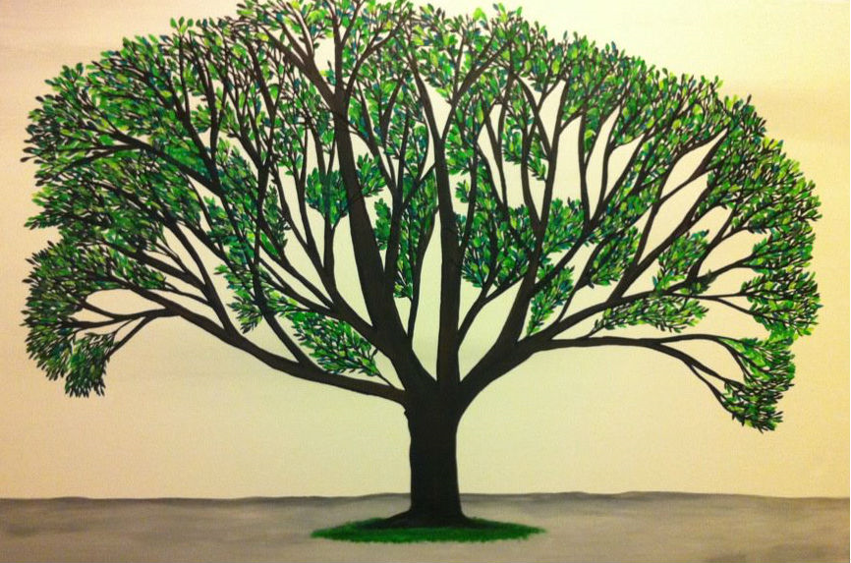
Initially - top-down
Principal
St Andrews Lutheran College – A Positive School
SERVE-GROW-FLOURISH
Well Being and Positive Education
(Published Jan 2012)
Champions
Staff
www.PESA.edu.au © PESA 2018
Notes:
Tania
Through inquiry and sharing applicable information school-wide (P-12) throughout 2012-2015 stimulated new ideas, stories and images that generated new possibilities for action. (Cooperrider and Whitney)
Thus it was almost easy for Positive Education to take hold and become part of the way we do things around here.
James
Principal initial publications, soon after teachers leading learning and publishing…

Slide 8
2014 - Ground-swell of uptake leading to the ripple effect
Staff Sharing:
Wellbeing Theory (PERMA Framework)
Character Strengths, Mindfulness,
Gratitude Journal, Meditation &
3 Good Things
PPI’s are “intentional activities that aim to increase wellbeing through the cultivation of positive feelings, cognitions and behaviours” (Green, Oades & Robinson, 2011).
Notes:
Tania or James
Share the little fires that burned and the fruit on tree, incorporate language or ripple.
Through sharing knowledge, stories about our organisation with a focus on the positive led to an obvious positive effect, social bonding, excitement, inspiration and camaraderie. Personally, working with our pastoral care teachers, year level coordinators in the SS resulted in some of my best, most positive and productive years in education.
Fortunately, we were in a situation where leadership monitored and supported the ideas, events and processes for the uptake and sustainability of positive education at St Andrews (Kessler, 2013).

Slide 9
Success of the approach due to:
effective leadership
champions to model positive education so it is authentic
aligning the positive education policy with the overall school climate (Noble & McGrath, 2008)
the use of evidence to inform staff of the effectiveness of using positive psychology interventions (PPI’s) in building student wellbeing (Waters, 2011)
a considered blend of engaging external presenters
Seligman, Ernst, Gillham, Reivich & Linkins, 2009
Live It
Teach It
Embed it
Positive Education to enhance wellbeing and academic engagement
www.PESA.edu.au © PESA 2018
Notes:
Tania
The challenge for teachers to embrace
The multifaceted approach where a leader was supporting, educating and made it visible, senior leader (myself) sharing personal learning, research, resources and sharing, key staff and leaders creating resources, appraisal becoming a growth conversation, teachers sharing their own journeys and teachings. It felt like there was a groundswell and it was a key focus.
Strong practical focus on infusing positive psychology school-wide – doing it and not just talking about it. More about jumping in and more importantly using what we already had and did to take action.
James
The mantra ‘It’s not about making people happy. It’s about more accurate thinking and more healthy relationships.’
‘It’s good for student learning and makes our job easier.’

Slide 10
Discover
Appreciating: the best of what is …
www.PESA.edu.au © PESA 2018
Notes:
Appreciating…
Best of what is…
a high point in your professional life
a time when you felt most alive, most engaged, or really proud of what you’d achieved."
the most challenging and exciting career opportunity you’ve experienced."

Slide 11
Experiences
Annual and Term outlines – PLF
Journey markers – Year level
Subject integration
Inquiry and Action Research
Testing, data and too much information
Nothing substitutes for good pastoral care
www.PESA.edu.au © PESA 2018
Notes:
James insert…
Planner
Journey outlines
Subject integration
6 Foundations???? Clarify
Testing & data - - - mention Durlak – balance explicit teaching and implicit
Tania
comment on early data gathering, too much, and what we’ve settled on with BYS, yr 12 exit surveys, positive behaviours survey, GPA/EPA, Strenghts, Goals, Org and ‘diary as data’, interviews with students,

Slide 12
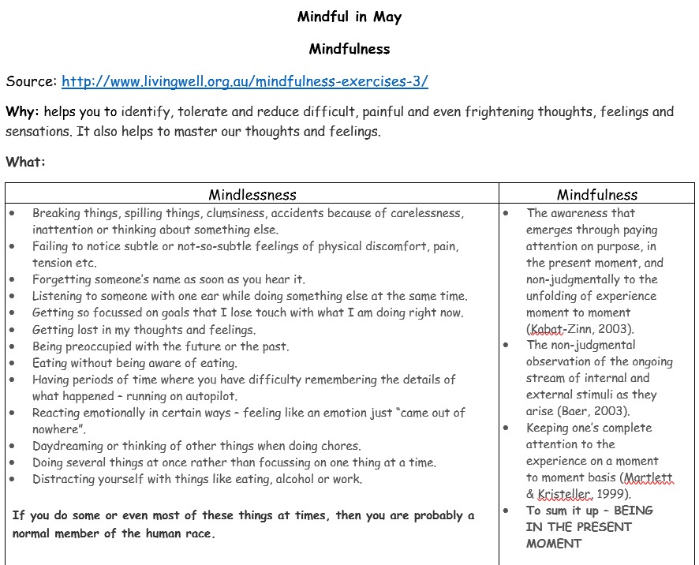
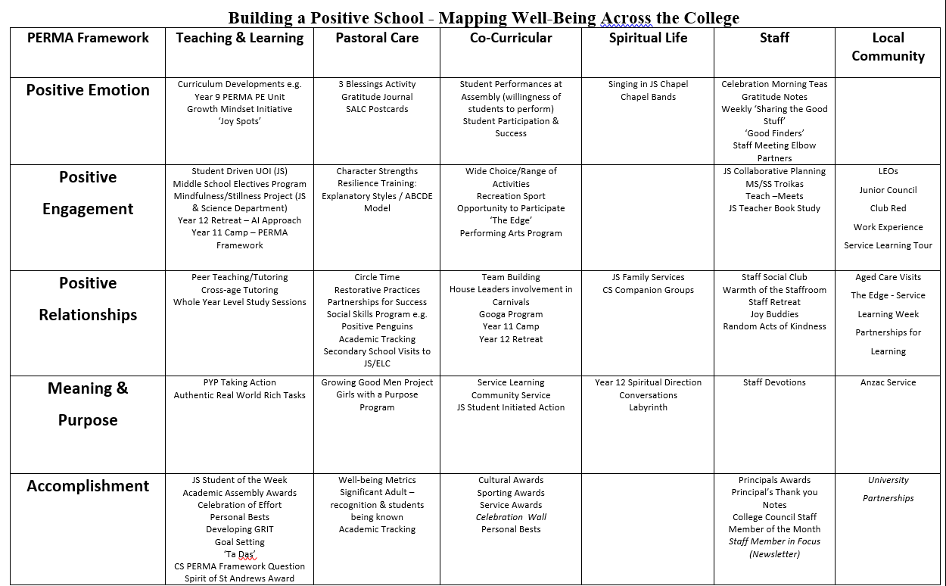
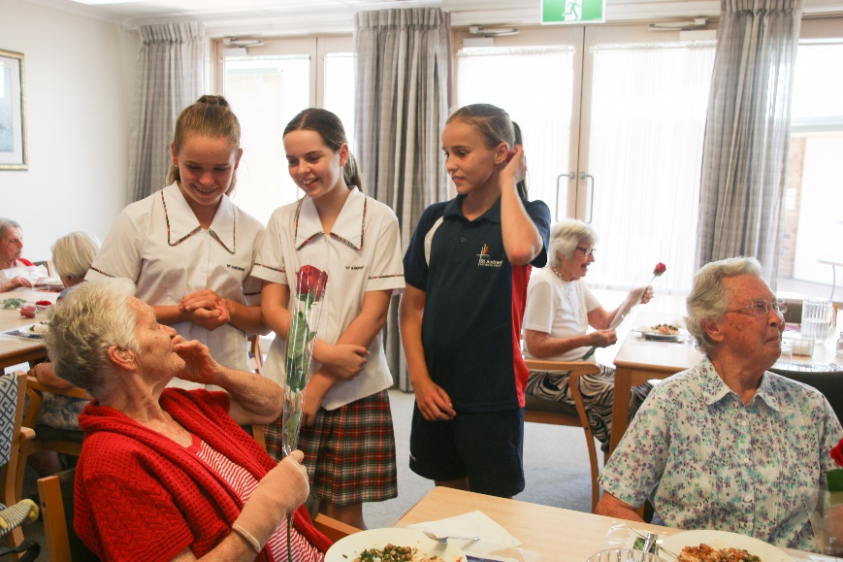
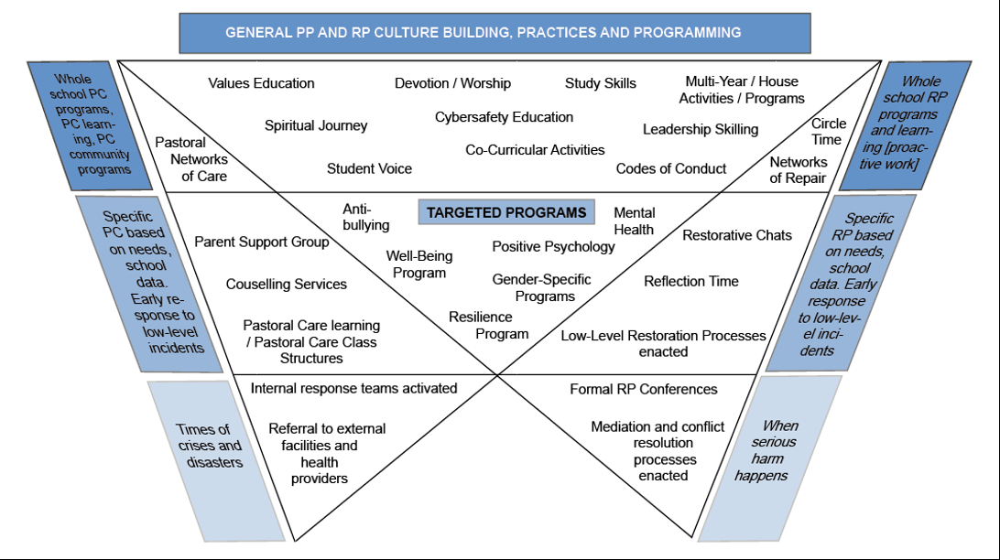
 | Year 10 | Year 11 | Year 12
Themes | Preparing for Senior | Preparing to Lead | Preparing to Launch
Community Service | Us… BEING Preparing for my Vocation. BELONGING Picnic in the dome + buddies. BECOMING Engagement with service initiatives offered by Senior students. | Our Community … Service within the St Andrews community including Aged Care, during Rec Sport – Term 2 CS. | Service-Learning…. Service beyond St Andrews incorporating LEOs, Captaincy, Mentoring + Buddies.
Pastoral focus
Term 1 Wisdom & Courage Learning & Personal Bests | Tighten Up – set the standard Foundations – knowing self strengths, Increasing in confidence of strengths. Becoming Goal oriented & Hope enabled (IB – Principled, Communicator) | Step up – teachers go hard straight away – lockers, on time, own behaviour Wisdom & Courage – Growing into expectations (LEA – Humility, IB – Principled, Reflective) | Months left, all you do counts – build cohesiveness Excelling together = Leadership + Teamwork. Individual and cohort accomplishment. (IB – Commitment, Confidence)
Term 2 Humanity, Love & Justice Community & Service | Destinations – work experience, social intelligence. Becoming value driven. (LEA – Appreciation, Justice, IB – Principled, Integrity, Empathy) | Kindness – Humanity, Love, Justice Service projects (CS) (LEA – Compassion, IB – Caring, Empathy) | Gratitude as part of St Andrews journey (LEA/IB – Appreciation)
Term 3 Temperance Growth & Integrity | Resilience – using feedback to reframe goals, committing to values and actions. Learning optimism and explanatory style. (IB – Principled, Integrity, Respect) | Temperance – self control, Prudence in Leadership (IB – Integrity, Tolerance, Respect) | Focus, Quality, Resilience and Excellence (LEA – Quality, IB – Courageous, Risk-taker)
Term 4 Transcendence Faith & Grace | PERMA – applying strengths to build wellbeing of self and others Social Intelligence – Getting Along + ACR (LEA – Quality, IB – Caring, Respect) | Staying the team and looking ahead (IB – Open-minded) | Perspective – savouring the St Andrews experience + Decision making (LEA – Appreciation, IB – Appreciation, Principled)
Whole School & Whole Year | Love of learning… Character strengths… | Persistence… PERMA… | Spirituality… Resilience…
Stillness in Science
Building teacher efficacy through coaching
Effects of teaching on Growth Mindset
Impact of teaching on Emotional Regulation
How can brief programs of service build emotional intelligence
www.PESA.edu.au © PESA 2018
Notes:
Artefacts…
James Brief!
Action learning – inquiry into efficacy and telling the story to staff – engaging and curious
5 areas of growth image smart art ie. Stillness (impact on school staff Katherine Weare) not just the good stuff in Durlak and others for kids
Insert images and artefacts
cup half full, Alli’s worksheet, EI data, staff Goals, year levels PCT planners
Crest, PLF? Activ8… (maybe a whole slide on activ8… and Jenny’s Mindfulness data…

Slide 13
Dream
Envisioning: what might be?
‘It’s the year… ‘.
www.PESA.edu.au © PESA 2018
Notes:
Tania
Envisioning results
What might be?
What do you see?
What are we doing together to create this?
Looking back - What were the key initiatives we undertook to create this success?
One year from now what might you hope to see around campus? Or in relationships between staff?

Slide 14
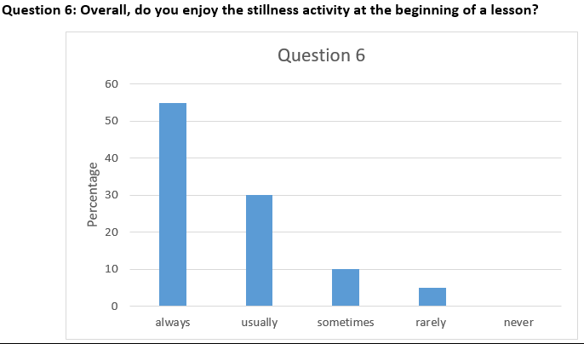
Planning
www.PESA.edu.au © PESA 2018
Notes:
5 year then… James
It was never about ‘problem to solve’ but questions we could engage with, what was good for people,
It was never about whole school change, it was about individual growth, aligning with our values for authenticity, enhancing community, relationships and student learning
It was drip feeding to those who were ready and giving oxygen to those who had little fires sparking, and avenues for curious teachers to test the effects…
3 year now… Tania
Visible values
Visible planning
Growth coaching (growth groups a re-tweak of troikas)
ALAR – action research or action learning
Decentralise – work with people’s strengths

Slide 15
Design
Co-constructing: what should be?
www.PESA.edu.au © PESA 2018
Notes:
Tania
Action plan?
What are 3 steps you and/or your team could take to move from where you are now to future you’ve just described?
…
One thing you could do in the next 48 hours that would begin your journey?
What could we do collectively that we could not do individually?
One person you can connect with now, agree to call in one week and see how that first thing went.
If you had three wishes – that were within your control – to make the future you’ve just described a reality, what would you wish for?"

Slide 16
Sustaining
Growing Deep
Deepening the roots
Adding to the fruit
www.PESA.edu.au © PESA 2018
Notes:
Tania
We mentioned challenge of new staff and new leadership, new buildings, new curriculum, new pedagogy….
Now the challenge to ‘deepen’ (our GD framework) but also ‘better, better, better’ (quests for bests)
Staff support and professional development

Slide 17
Sustaining
2018 – 2020
Visible Values
Visible Planning
Coaching – engagement, motivation, feedback data
AR – Leading Learning & Growth agenda
Decentralise – working with strengths
www.PESA.edu.au © PESA 2018
Notes:
James
We mentioned… visible, engageing, learning, decentralise…

Slide 18
Deliver
Sustaining: what will be
www.PESA.edu.au © PESA 2018
Notes:
Tania & James
- What two to three aspects can we focus on now?
• What opportunities are there for us to move these ideas forward?

Slide 19
www.PESA.edu.au © PESA 2018

