Slide 1
2017
Making Wellbeing Visible
www.PESA.edu.au © PESA 2018

Slide 2
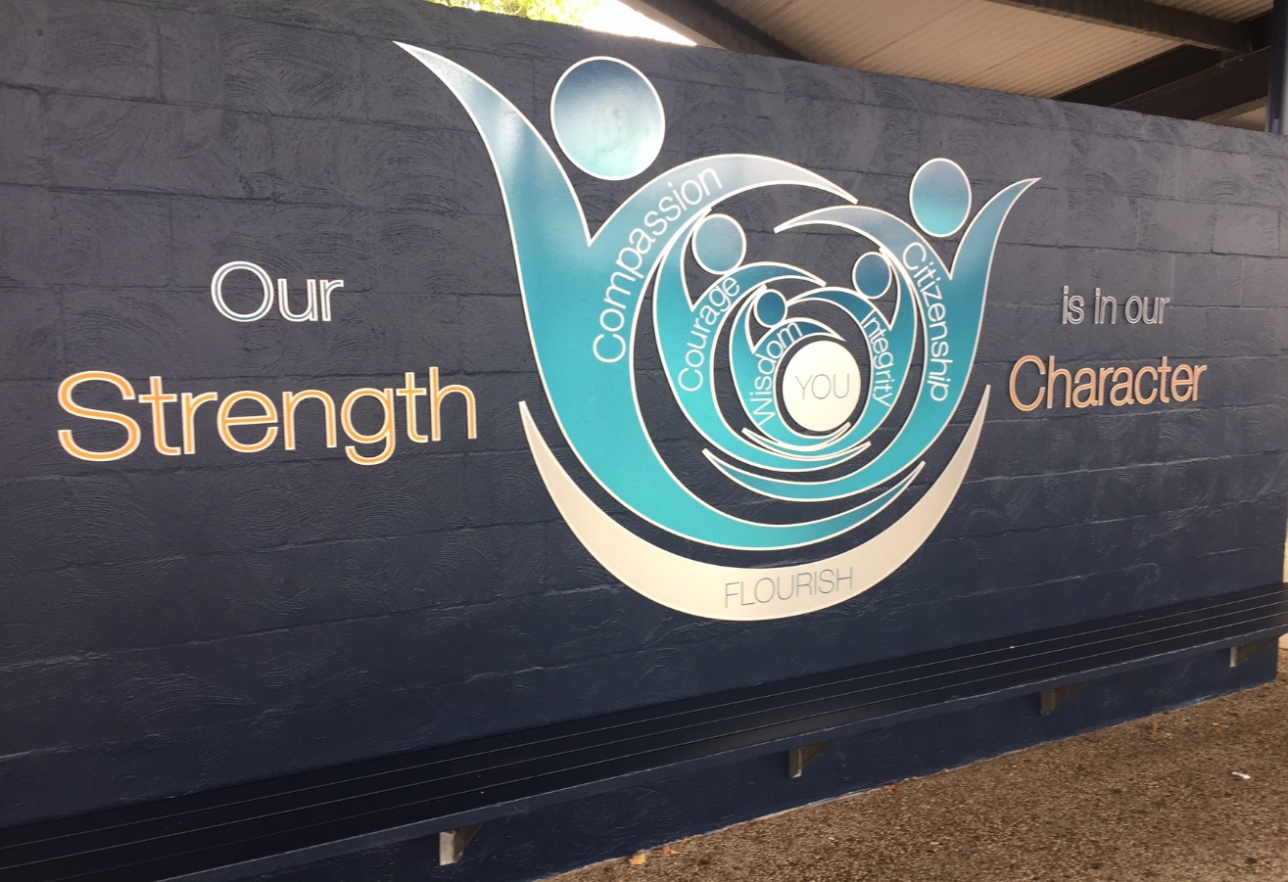
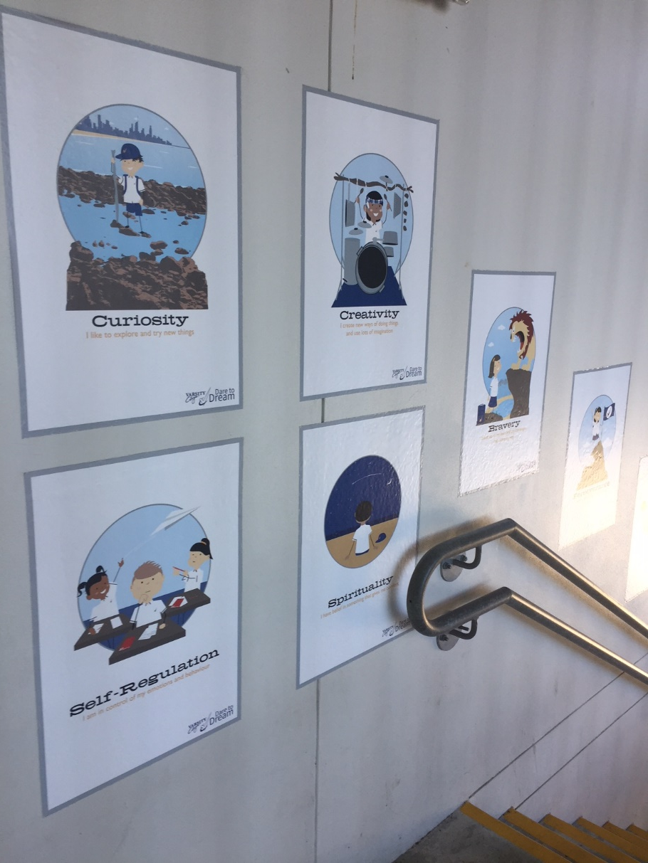
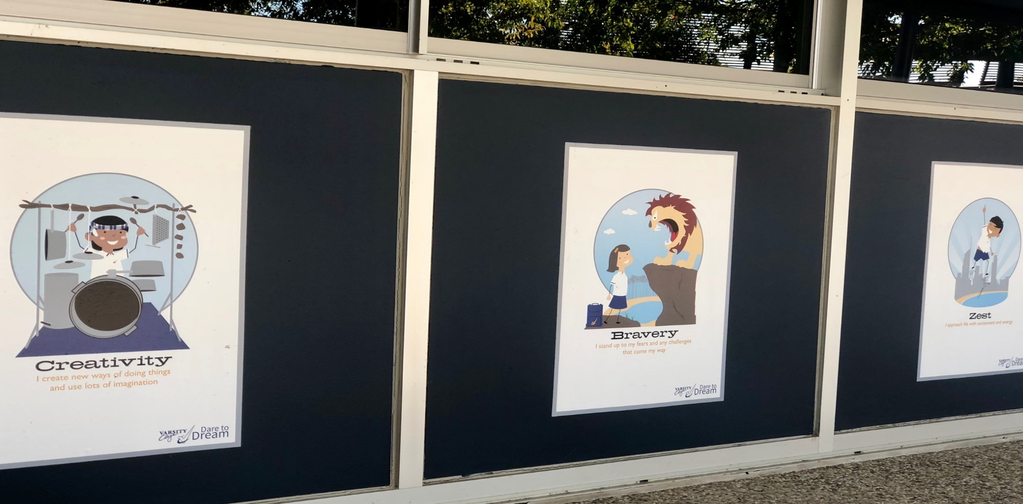
2017
www.PESA.edu.au © PESA 2018

Slide 3
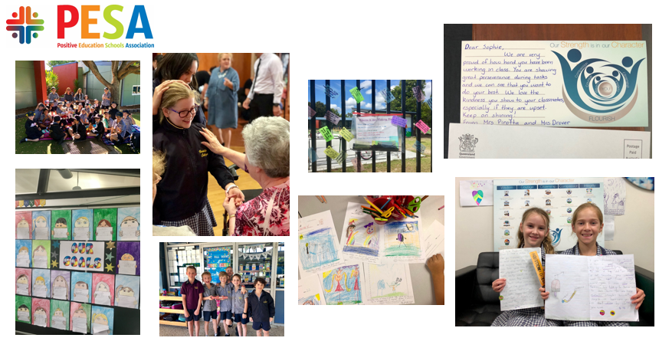
www.PESA.edu.au © PESA 2018

Slide 4
2017
www.PESA.edu.au © PESA 2018

Slide 5
2017
www.PESA.edu.au © PESA 2018

Slide 6
2017
Closing Circle
www.PESA.edu.au © PESA 2018

Slide 7
2017
“The real potential for growth, development and success
lies in your existing areas of strength”
(Fox Eades, 2008)
www.PESA.edu.au © PESA 2018

