Slide 1

Our Strength Is in Our Character: How To Embed The Language And Practice Of Character Strengths In Australia’s Largest Public School
Victoria McLuckie, Marita Frazer, Paul Sochanik and Phillip Pearce
Varsity College
www.PESA.edu.au © PESA 2018

Slide 2

Positive Primer
www.PESA.edu.au © PESA 2018

Slide 3
Goal: To view how Australia’s largest public school embed the language and practice of Character Strengths.
Success criteria: I feel more confident in my ability to embed the language and practice of Character Strengths in my own context.
www.PESA.edu.au © PESA 2018

Slide 4
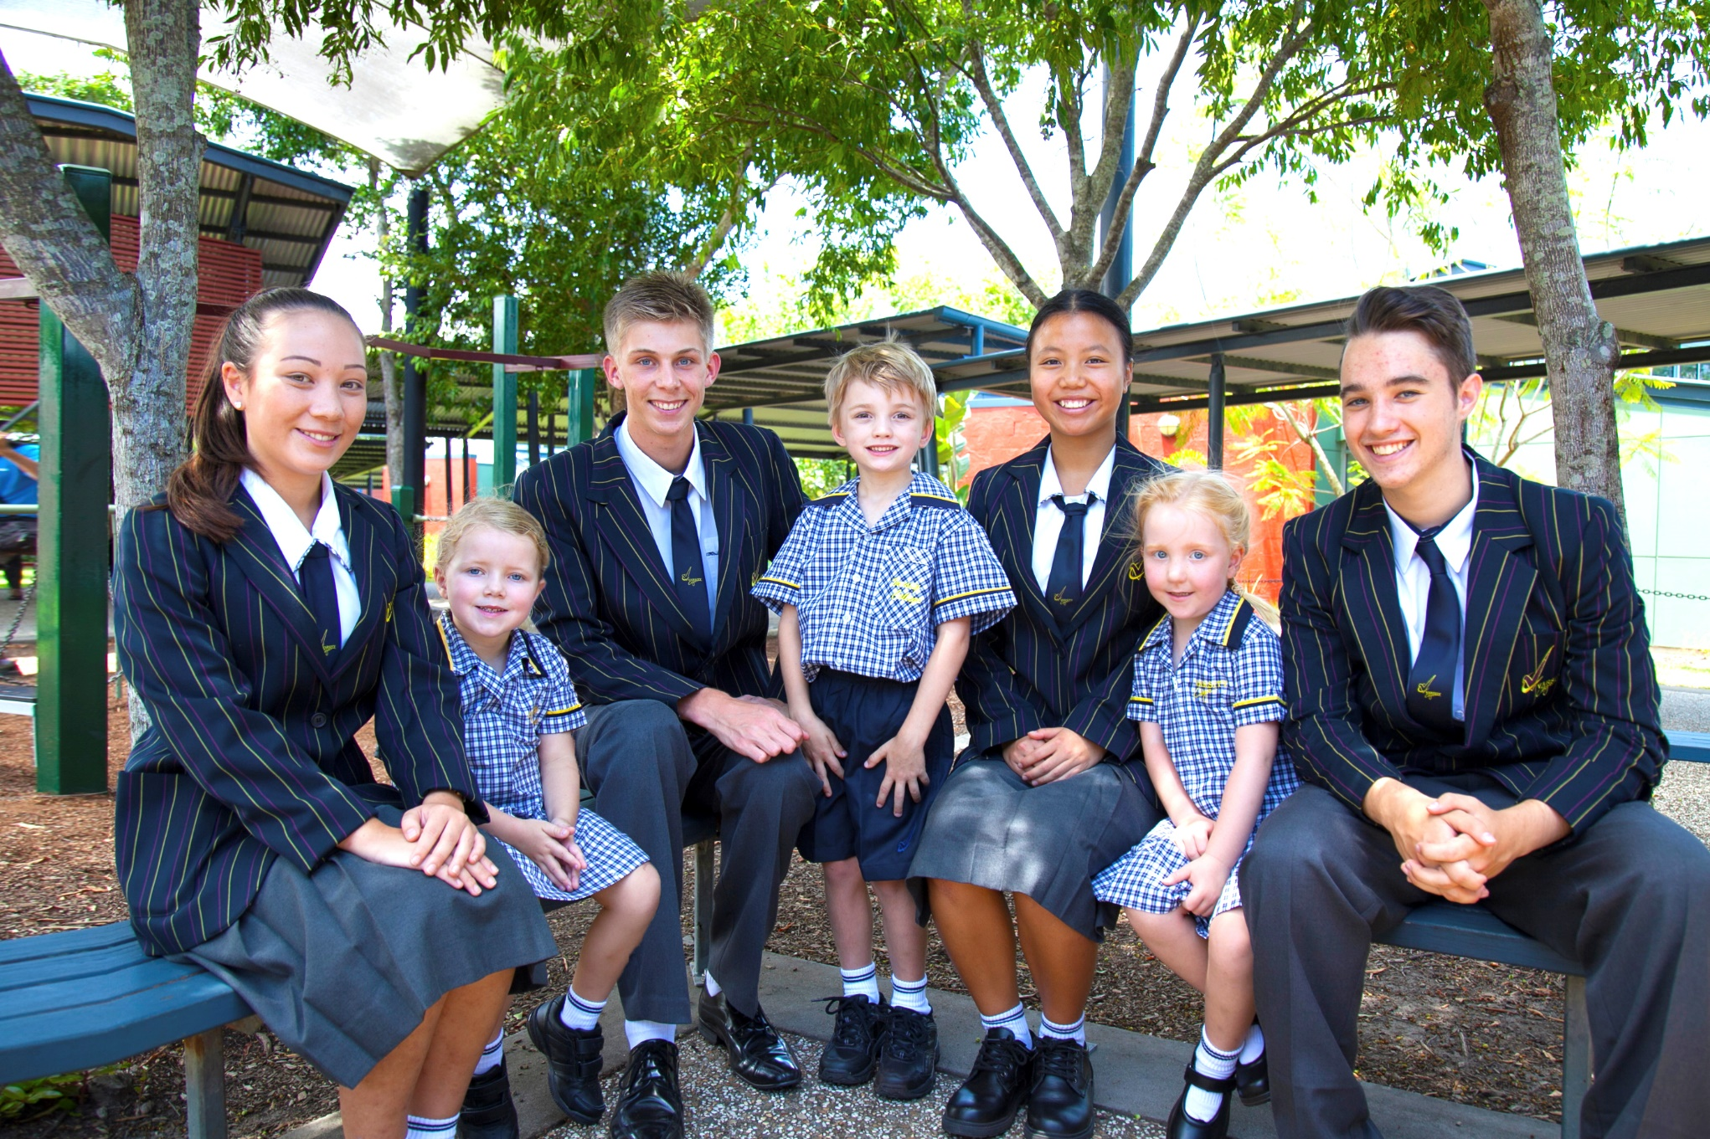
School context
P-12 public school located on the Gold Coast
Approx. 3300 students across two campuses (7 minute drive apart)
Predicted to grow to 3500 in the next two years
350 staff
Large variation in SES
Strong academic results
www.PESA.edu.au © PESA 2018

Slide 5
Our journey…….. 2016
AWARE
EXPLORE
APPLY
PD with whole staff – CS wheel
Aligned school values to VIA
Leadership team begin embedding character strength based language with students, staff and parents
Staff meetings – Introduce CS language
Twilight teams
Wellbeing team – focus on staff wellbeing
Introduced strength certificates
Character strength emoji competition
Rebrand school with new Flourish logo – Our Strength is in our Character
www.PESA.edu.au © PESA 2018

Slide 6
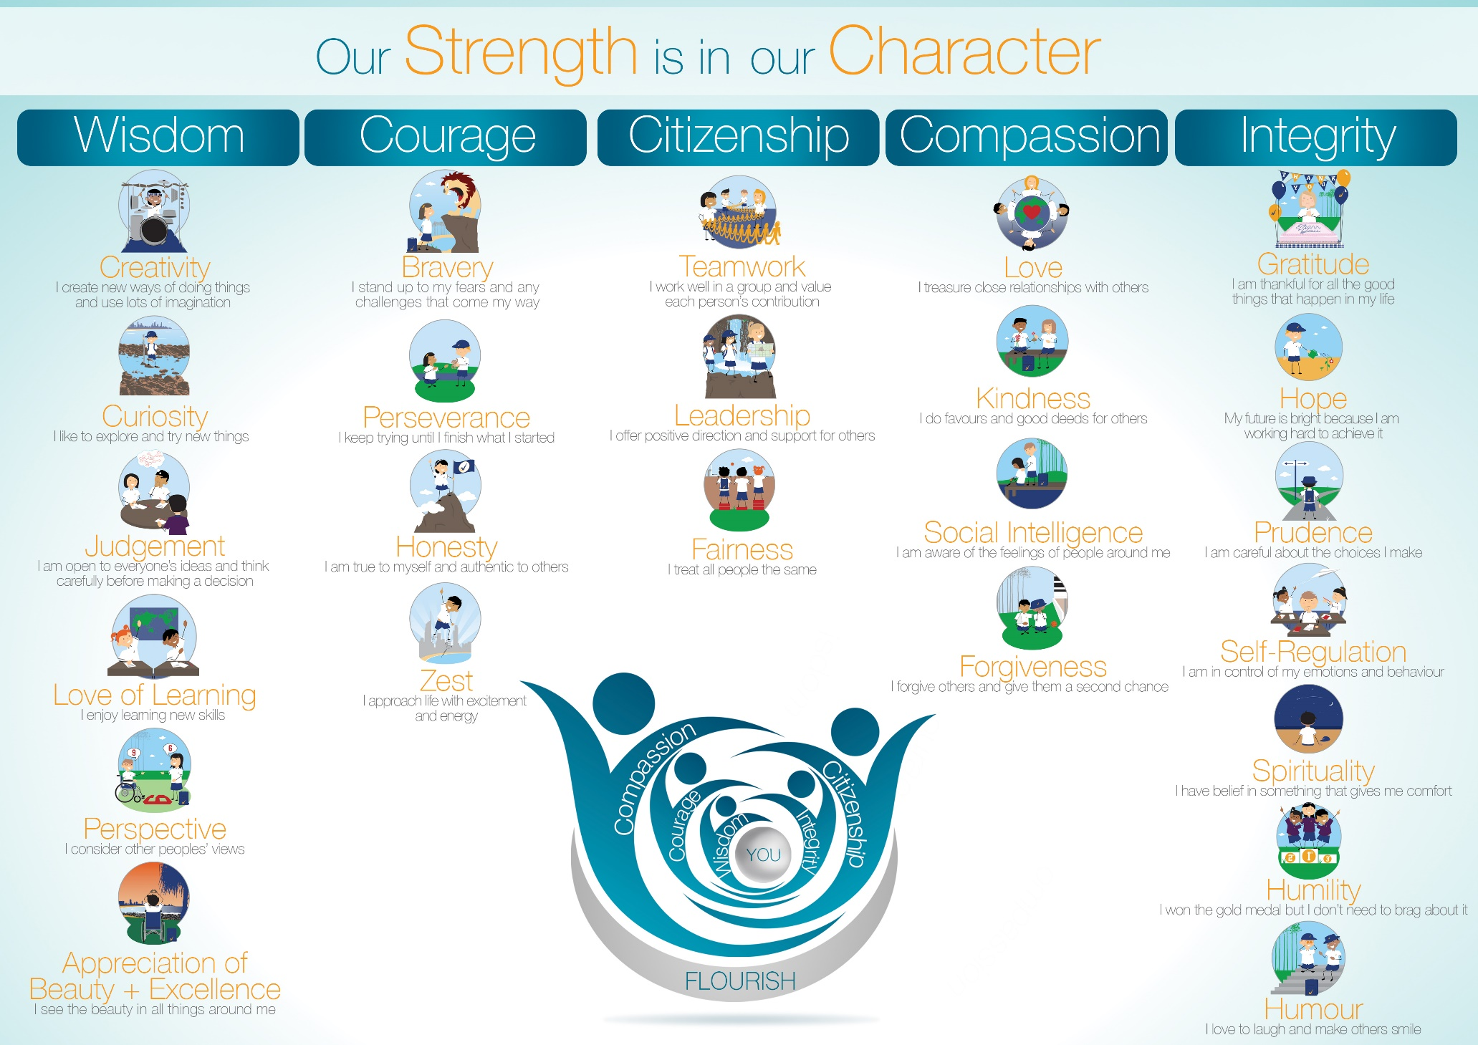
2017
www.PESA.edu.au © PESA 2018

Slide 7
2017
Our journey…….. 2017
AWARE
EXPLORE
APPLY
Visible Wellbeing survey for staff and students years 5-12 (baseline measure)
Whole college PD with Professor Lea Waters – Strengths pathway
VIA survey (staff and students)
Developed VWB implementation team
Staff meetings – Positive Primers
Twilight teams
Creation of the VWB team
Development of OneNote for resources
ICP and PLP Character strength development
Introduction of STYMIE
Fortnightly CS focus
Assembly segment
Email with pedagogical ideas – the HOW
Character strengths awards – strengths spotting
Whole college focus (Gratitude, Kindness, and Compassion)
Random acts of kindness
Student led initiatives
Fundraising for the community
Quote of the day in daily notices
www.PESA.edu.au © PESA 2018

Slide 8

Our journey…2018
AWARE
EXPLORE
APPLY
VIA survey (staff and students)
Development of database of student CS data
Whole College/Faculty/Team CS data
VWB survey: 12-month data collection
Intentional use of CS data
How will HODS/school leaders/teachers utilise this data to intentionally improve wellbeing across the college?
Twilight sessions
Strength-based parenting workshop (Lea Waters)
Underuse and Overuse of strengths
VWB team – early adopters
Use of database:
Intervention
Individual student connection/engagement
Whole class
Parent/Teacher interviews
SET Plan interviews
Adventurous Journey
Wellbeing Wednesday – Strengths Focus
VWB team – early implementation (Pedagogy)
Guide year level/college focus
Planning for Positive Education units
Staff meetings – Positive Primer/Brain Breaks
My signature strengths sticker days
I displayed the strength of……stickers
Signature strengths on laptop
School signage
Quick writes
Growth journal
Postcards
TV screens with messages of gratitude
www.PESA.edu.au © PESA 2018

Slide 9
2017
Data Analysis
  SCHOOL
  YEAR
  Class
  student
www.PESA.edu.au © PESA 2018

Slide 10
2017
Data Analysis
  School
  YEAR
  Class
  student
Year 12 Strengths
www.PESA.edu.au © PESA 2018

Slide 11
2017
Data Analysis
  School
  Year
  CLASS
  student
www.PESA.edu.au © PESA 2018

Slide 12
2017
Data Analysis
  School
  Year
  Class
  STUDENT
Student Name |  | Top 5 Signature Strengths
 |  | First | Second | Third | Forth | Fifth
Franxx | Exxxx | Love | Prudence | Teamwork | Creativity | Fairness
Kaxx | Bxxxx | Humour | Kindness | Zest | Bravery | Love
Avxx | Sxxxx | Love | Gratitude | Humour | Social Intelligence | Teamwork
Natxxx | Gxxxx | Gratitude | Humility | Bravery | Zest | Forgiveness
Jetxxx | Dxxxx | Humour | Bravery | Creativity | Self-Regulation | Kindness
Soxxxx | Cxxxx | Zest | Bravery | Love | Humour | Social Intelligence
… | … | … | … | … | … | …
www.PESA.edu.au © PESA 2018

