Slide 1
Developing a survey of student wellbeing
Using a survey to continually review student context
by Marisca de Jager, School Psychologist
Julie Brunckhorst, Dean of Students
Somerville House
www.PESA.edu.au © PESA 2018

Slide 2
2015 – Introducing Positive Psychology to Somerville House
Justin Robinson of Geelong Grammar was invited to facilitate workshops with all staff to introduce Positive Education.
School leaders then considered how best to implement findings for Positive Psychology to Somerville House.
www.PESA.edu.au © PESA 2018

Slide 3
Some areas of research within Positive Psychology:
PERMA Positive emotions Engagement Relationships Meaning Accomplishments Hope Grit Growth Mindset Flow Mindfulness Gratitude Resilience Happiness Belonging Flourishing Goal Setting | Optimism Character Strengths and Virtues: Wisdom and knowledge: creativity, curiosity, open-mindedness, love of learning, perspective, innovation Courage: bravery, persistence, integrity, vitality, zest Humanity: love, kindness, social intelligence Justice: citizenship, fairness, leadership Temperance: forgiveness and mercy, humility, prudence, self control Transcendence: appreciation of beauty and excellence, gratitude, hope, humour, spirituality
www.PESA.edu.au © PESA 2018

Slide 4
www.PESA.edu.au © PESA 2018

Slide 5
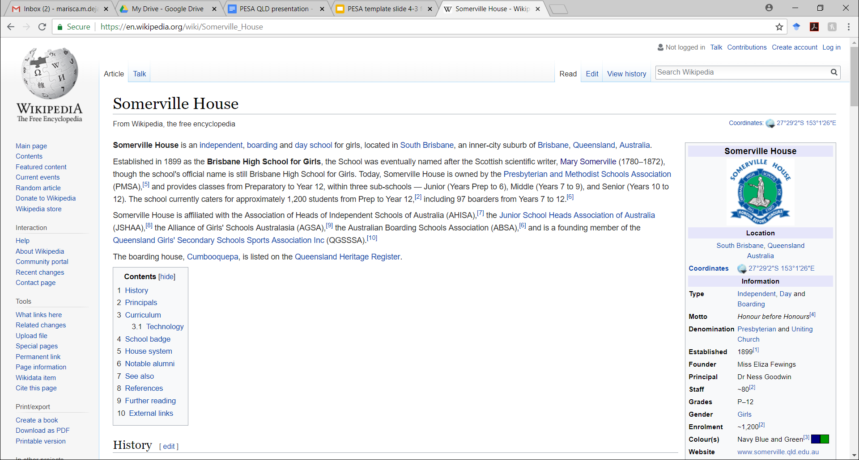
www.PESA.edu.au © PESA 2018

Slide 6
Group discussion
What is your school’s context?
Does this context naturally lend itself to certain themes within Positive Psychology?
www.PESA.edu.au © PESA 2018

Slide 7
2015 – Introducing Positive Psychology to Somerville House
2016 – Search for a survey
Investigated commercial products available at the time. Found many to be excellent but inflexible.
Referred to 2015 paper “A multi-dimensional approach to measuring wellbeing in students: Application of the PERMA framework” by Kern, Water, Adler and White. Also drew from the 2014 research report evaluating Positive Education at Geelong Grammar by Vella-Brodrick, Rickard and Chin.
Began consultation to compile our own student wellbeing survey using model described in these papers.
www.PESA.edu.au © PESA 2018

Slide 8
2015 – Introducing Positive Psychology to Somerville House
2016 – Search for a survey
Undertook a literature review, specifically of potential surveys and measuring tools. Found a plethora of constructs, concepts and models associated with wellbeing.
Measures were selected to reflect the model of wellbeing in place at the time at Somerville House. This was based on Seligman’s PERMA model.
Applied the following considerations to select measures:
Appropriateness of intended use (validity)
Technical adequacy (reliability)
Usability (breadth vs brevity, age-appropriateness, administration requirements, cost and availability of screening tools)
www.PESA.edu.au © PESA 2018

Slide 9
2015 – Introducing Positive Psychology to Somerville House
2016 – Search for a survey
Tools were selected to measure the following constructs: | Following further staff consultation additional measures were added:
Engagement Perseverance Optimism Connectedness Happiness Self-esteem Resilience Meaning Gratitude Overall wellbeing Negative Affect: Depression, Anxiety, Stress | Perception of safety at school Perception of safety online Perceived sleep pattern Perfectionism Measure of body esteem
www.PESA.edu.au © PESA 2018

Slide 10
2015 – Introducing Positive Psychology to Somerville House
2016 – Search for a survey
All questions were presented in a Likert-style format where students are asked to match a statement such as “I feel happy” to a 5 point scale ranging from “Almost Never” to “Almost Always”(from the EPOCH scale by Kern et al, 2016).
We used SurveyMonkey as the platform to administer the survey to students. Students used their school-issued laptops to access survey.
Data was exported from SurveyMonkey and analysed by School Psychologist using Microsoft Excel software.
Students were not personally identified and provided only their current Year Level.
www.PESA.edu.au © PESA 2018

Slide 11
2015 – Introducing Positive Psychology to Somerville House
2016 – Search for a survey
Approval was sought:
- Within the school – through the Principal, School Executive and Pastoral Care team
- From parents who were emailed comprehensive information and a ‘Parent non- consent’ form to complete and return.
- With teachers who were kept informed about the survey and delivery process. Tutor teachers were provided with a script of instructions to allow consistency between classes.
- From students who were provided with written and aural information about the survey, the confidential nature of data collected, the voluntary nature of participation and their ability to abstain or withdraw at any time. Students were encouraged to attend or contact Student Services with questions or concerns.
www.PESA.edu.au © PESA 2018

Slide 12
2015 – Introducing Positive Psychology to Somerville House
2016 – Search for a survey
2016 – Conducting the first survey
A date was selected for the middle of Term 4, 2016.
Students received a link to the survey via email and completed the survey during non-academic time in a morning tutor session. All students were supervised in small groups during completion.
Almost all participants were able to complete the task within the 20 minute lesson time.
A total of 813 students participated, with 738 completing the entire survey. High level of participation led to a representative sample.
www.PESA.edu.au © PESA 2018

Slide 13
2015 – Introducing Positive Psychology to Somerville House
2016 – Search for a survey
2016 – Conducting the first survey
Results were analysed and presented by Year Level, Sub-school independently (Middle and Senior School) and then together.
Comparisons were made between Year Levels and Sub-Schools.
Comparisons were made with levels reported in research literature.
Correlations between constructs were provided.
www.PESA.edu.au © PESA 2018

Slide 14
2015 – Introducing Positive Psychology to Somerville House
2016 – Search for a survey
2016 – Conducting the first survey
Results were presented to School Executive and this promoted discussion about:
The level of wellbeing reported by students
How wellbeing is measured over time
The impact and effectiveness of current programs
Education for teachers, parents and students
A second study at an alternate time of year was recommended, to ensure that results were representative of wellbeing levels across the school year (not just of wellbeing levels in Term 4).
www.PESA.edu.au © PESA 2018

Slide 15
2015 – Introducing Positive Psychology to Somerville House
2016 – Search for a survey
2016 – Conducting the first survey
2017 – Conducting the second survey
All survey items were appraised and modified where necessary.
Further items were created to extend our understanding of areas of student concern, in general and at school.
Questions about connectedness and belonging at school were added.
Students were asked to identify whether they were a boarding or day student.
The subscale measuring Meaning (Peterson & Seligman, 2005) was removed due to student and teacher feedback. It was indicated that younger students found some items such as “My life has lasting meaning” to be confusing and abstract.
www.PESA.edu.au © PESA 2018

Slide 16
2015 – Introducing Positive Psychology to Somerville House
2016 – Search for a survey
2016 – Conducting the first survey
2017 – Conducting the second survey
Data was analysed using more specialised software. SPSS Statistics 24 software was found to allow more rapid processing of data.
Results were shown to be relatively stable across the two survey dates (middle of Term 4 and Term 1).
Outcomes were more widely shared and began to influence decision making within our Pastoral Care program.
Outcomes prompted the discussion of specific themes at parent information evenings, and directed our focus and timing of specific programs (such as Body Positivity and Sleep Hygiene).
The outcomes also influenced decisions within the wider School community such as the finish time of evening events for students.
www.PESA.edu.au © PESA 2018

Slide 17
2015 – Introducing Positive Psychology to Somerville House
2016 – Search for a survey
2016 – Conducting the first survey
2017 – Conducting the second survey
A second survey allowed more confidence in the reliability of our data, but also meant that the amount of data available grew.
Summarising data and communicating it effectively became challenging.
A 60 minute staff presentation of survey outcomes in 2017 indicated to us that too much data could be overwhelming and unhelpful. Alternative ways of disseminated survey outcomes were considered.
Now we generally disseminate summaries and highlight specific information for teachers and leaders for decision making.
www.PESA.edu.au © PESA 2018

Slide 18
2015 – Introducing Positive Psychology to Somerville House
2016 – Search for a survey
2016 – Conducting the first survey
2017 – Conducting the second survey
2017 – Conducting the third survey
Third survey was conducted in Term 4, 2017 to allow for comparison with first survey from Term 4, 2016.
Comment boxes were added to invite unstructured feedback from students.
Four questions were added considering the impact of peer comparisons on wellbeing in line with research by Lyman & Luther (2014). Unfortunately this item was not properly pilot tested and a glitch meant that all data from these questions were omitted from analyses.
www.PESA.edu.au © PESA 2018

Slide 19
2015 – Introducing Positive Psychology to Somerville House
2016 – Search for a survey
2016 – Conducting the first survey
2017 – Conducting the second survey
2017 – Conducting the third survey
After the third survey we began to find effects specific to a particular cohort, and other effects which appeared at a specific period of time or development.
For example: 1. Some cohorts have higher levels of perseverance and this is maintained as they ascend the year levels.
2. Across cohorts, self reported hours of sleep decreases with age, as does parental influence on sleep.
This allowed further refinement of wellbeing strategies in response to cohort and developmental findings.
www.PESA.edu.au © PESA 2018

Slide 20
2015 – Introducing Positive Psychology to Somerville House
2016 – Search for a survey
2016 – Conducting the first survey
2017 – Conducting the second survey
2017 – Conducting the third survey
2018 – Conducting the fourth survey
Added a new demographic variable asking students to identify as a new or returning student.
Added a question asking if students meet the media/social technology guidelines for entertainment.
Allowed analysis of cohorts over 3 years, for instance: Term 1 Year 12, Term 4 Year 11, Term 1 Year 11 and Term 4 Year 10. This is valuable information to track how cohorts fare over time as they encounter challenges and opportunities.
www.PESA.edu.au © PESA 2018

Slide 21
Advantages | Disadvantages
Allows a deeper understanding of our specific context over time Responsive to our needs, social circumstances and trends emerging in research literature Flexibility to evolve, based on needs arising. Time effective and fits within school schedule. Security for parents to know that data remains within the School and does not inform wider data bank Minimal financial cost | Arduous process of research to compile measures Onerous process of data analysis and description Time lag for results due to competing demands on staff Comparisons cannot be drawn as neatly with other schools or national samples Expensive in terms of staff time for processing
www.PESA.edu.au © PESA 2018

Slide 22
Where to from here?
Ongoing refinement of our Positive Wellbeing model in response to survey results
Positive Education Audit
Increase our Positive Education profile / showcasing of current practice
Refinement of Pastoral Program to align with new demands of Australian Curriculum
Further embedding Positive Education across the curriculum
More effective dissemination and sharing of results with parents, students and staff
Sharing our experience and results through presentation and publishing
www.PESA.edu.au © PESA 2018

Slide 23
Take away points:
A lot of work but possible
Inexpensive
Needs to be flexible to your cultural context
Able to determine trends for particular cohorts/ developmental stage
Responsive and adaptable to new research literature as it emerges
Allows for continual review of specific needs
Explore surveys in the public domain and select tools to meet your needs
Utilise statisticians on staff (e.g. Psychologists, Mathematics and IT staff) seek consultants for this purpose if necessary.
Simple to administer – very little time burden for students/teachers
Allows for relatively quick/ direct feedback after implementation of new programs
www.PESA.edu.au © PESA 2018

Slide 24
Questions and further discussion
www.PESA.edu.au © PESA 2018

