Slide 1
Positive Education Journey
Nerieda Anderson
www.PESA.edu.au © PESA 2018

Slide 2
Calamvale Community College’s
Positive Education Journey

Slide 3
This Workshop
Documenting CCC’s Journey
Highlighting strategic decisions made through the lens of Kotter’s Change Management Model

Slide 4
Kotter’s Model of Change Management
Developing a culture that engages with Positive Education has many facets but is essentially a large-scale change management challenge
Winning the hearts and minds of staff, students and the community requires explicit change management strategies from the very first planning meeting

Slide 5
Creating the climate for change
1. Create a sense of urgency
Kotter’s Change Management Model
2. Form a powerful coalition
3. Create a vision for change
Student Wellbeing
Programs
Staff
Resources
Culture
Engaging and enabling the organisation for change
4. Communicate the vision
5. Empower action
6. Create quick wins
Implementing and sustaining for change
7. Build on the change
8. Make it stick

Slide 6
1. Create a sense of urgency
The imperative ‘why’ – what data did we have?
Increasing concerns about our students’ mental health
Continuing high-level behaviours
No specific wellbeing programs or philosophy
Reactive culture, not proactive

Slide 7
2. Form a powerful coalition
Who are the key stakeholders and how do we get them on side?
Support from Principal is key
Positive Education team
Other school leaders

Slide 8
3. Create a vision for change
This is when it got tricky!
Team spent hours poring over literature – engaged with GGS’ framework
Identified two main things that would need continual focus:
Our philosophy
Branding of the initiative for staff

Slide 9
3. Create a vision for change
Positive Education concepts will underpin all interactions between all people at the College and will be delivered in embedded curriculum and stand alone lessons.
Staff and students will both benefit from engagement with Positive Education in school life and personal life.
Staff will need to have Positive Education modelled by leadership in all contexts to ensure traction.
Staff training will be the key step in the process and must be prioritised – 2 years staff, then students.

Slide 10
4. Communicate the vision
How could we communicate our Positive Education philosophy?
1. Buy-in/participation from senior management
2. Regular formal interactions with staff
3. Buy-in from middle management
4. Branding, branding, branding for staff
5. Implementation Plan publication
6. Keep messages simple and clear, and training targeted

Slide 11
5. Empower action
The Background Work / Building the Nest
1. Development of house culture in JS and SS – not just sport
That’s Gold and House Cup initiatives
Secondary School staff rooms based on House not faculty
2. Planning alignment with International Baccalaureate
3. Wellbeing survey
4. Restorative Practice model for addressing relational conflict
5. Rewriting of policies/procedures to embed a Pos Ed approach (e.g., Responsible Behaviour Plan for Students, welfare structure)

Slide 12
5. Empower action
What does our staff training look like?
A lecture-style session each term
Term tasks (long-term and short-term challenges set up for staff to engage with positive psychology between sessions)
An interactive workshop to follow the lecture session
Sessions include a team-building focus

Slide 13
5. Empower action
What does our staff training look like?
Y1, T1: one-day introduction covering philosophy, branding and all branches briefly
strong focus on staff feedback
Lecture-Style Session and Workshop Focus
Y1, T1: CHARACTER STRENGTHS and POSITIVE EMOTIONS
Y1, T2: POSITIVE RELATIONSHIPS (including gratitude)
Y1, T3: POSITIVE ENGAGEMENT
Y1, T4: POSITIVE PURPOSE
Y2, T1: POSITIVE ACCOMPLISHMENT
Y2, T2: POSITIVE HEALTH
Y2, T3: POSITIVE EDUCATION CURRICULUM DEVELOPMENT (HIGH LEVEL STAFF COLLABORATION)
Y2, T4: POSITIVE EDUCATION & PEDAGOGY (HIGH LEVEL STAFF COLLABORATION)

Slide 14
6. Create quick wins
What did we do to create quick wins and celebrate success?
Celebrating engagement with Pos Ed – individual and group
Leaders modelling Pos Ed and highlighting their experiences
Staff sharing stories about engagement with Pos Ed
Pos Edu formal agenda item (e.g., meeting starters)

Slide 15
7. Build on change
How did Pos Ed grow as time passed?
The more we were doing, the more connections we made
Easy to link Pos Ed concepts with College priorities
Pos Ed started to shift from a stand-alone concept to many links in daily practices
Recruited ‘guest’ staff members to co-present with a Pos Ed Team member

Slide 16
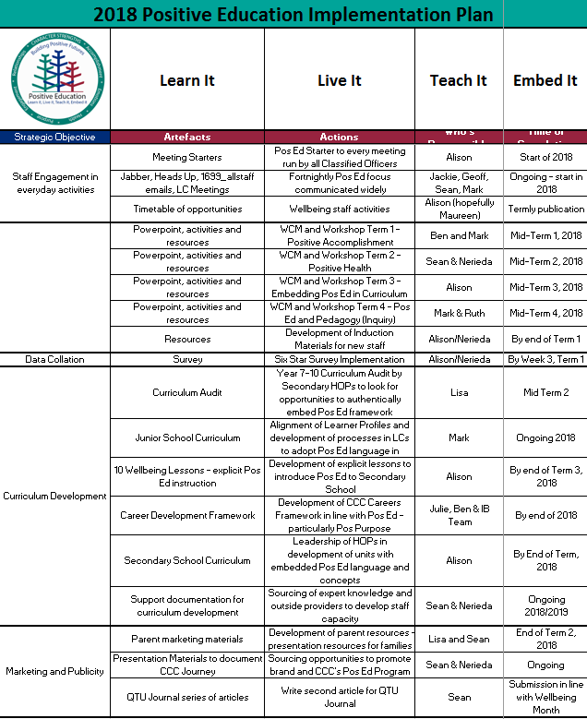
Team roles and responsibilities

Slide 17
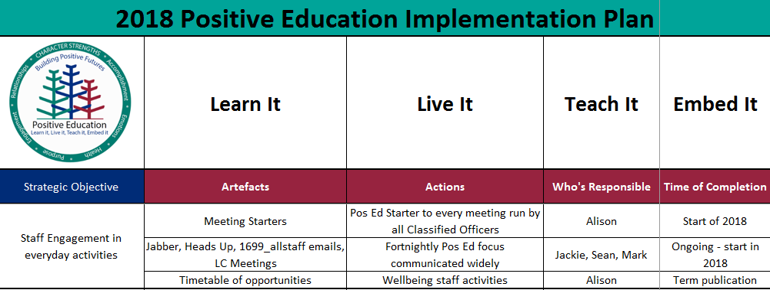
Team roles and responsibilities

Slide 18
Why are we only bringing up curriculum in the second year?
There are a few distinct reasons.
Curriculum means little without staff engagement –
- staff first, curriculum development second, students third
When staff are ‘believers’, curriculum opportunities will be seized by them – we started witnessing this broadly across the College very quickly

Slide 19
What we’re doing so far with curriculum
Junior School: planning to align IB PYP Learner Attributes with Character Strengths
Secondary School: fortnightly wellbeing lessons and assembly includes introductory learning experiences related to Pos Edu
Secondary School: engaging in a Years 7-10 curriculum audit to look for authentic opportunities to embed Pos Ed into assessment items for 2019
- Goal: one formal assessment piece overtly including Pos Ed language and concepts per semester, per year level, per subject
P-12: thinking about how to educate and include parents

Slide 20
Overall, what we have learned so far
Long-term planning is key to success
Branding is important – develop a brand and promote it
No surprises for staff – everything on the horizon is known well in advance
Set expectations high for staff engagement – don’t allow opting out, only a differentiated version of the task
Listen to your staff – they will guide you in a direction that is intrinsically motivating for them
Less is more and hasten slowly - brings the best results with developing staff culture

Slide 21
8. Making it stick
The foot can never come off the accelerator!
But above all…

Slide 22
Never miss an opportunity!

