Slide 1

MENTAL TOUGHNESS for Teens
Kate Wilkie – The Positivity Institute
Madonna Ahern-Mt St Michael’s College
Kathy James-Mt St Michael’s College
www.PESA.edu.au © PESA 2018

Slide 2

What we do…….
We help the world to flourish by creating meaningful and sustainable positive change for individuals, schools and workplaces.
We’re recognised world leaders in applying cutting-edge scientific research to sustainably transform well-being and enhance performance.
www.PESA.edu.au © PESA 2018

Slide 3
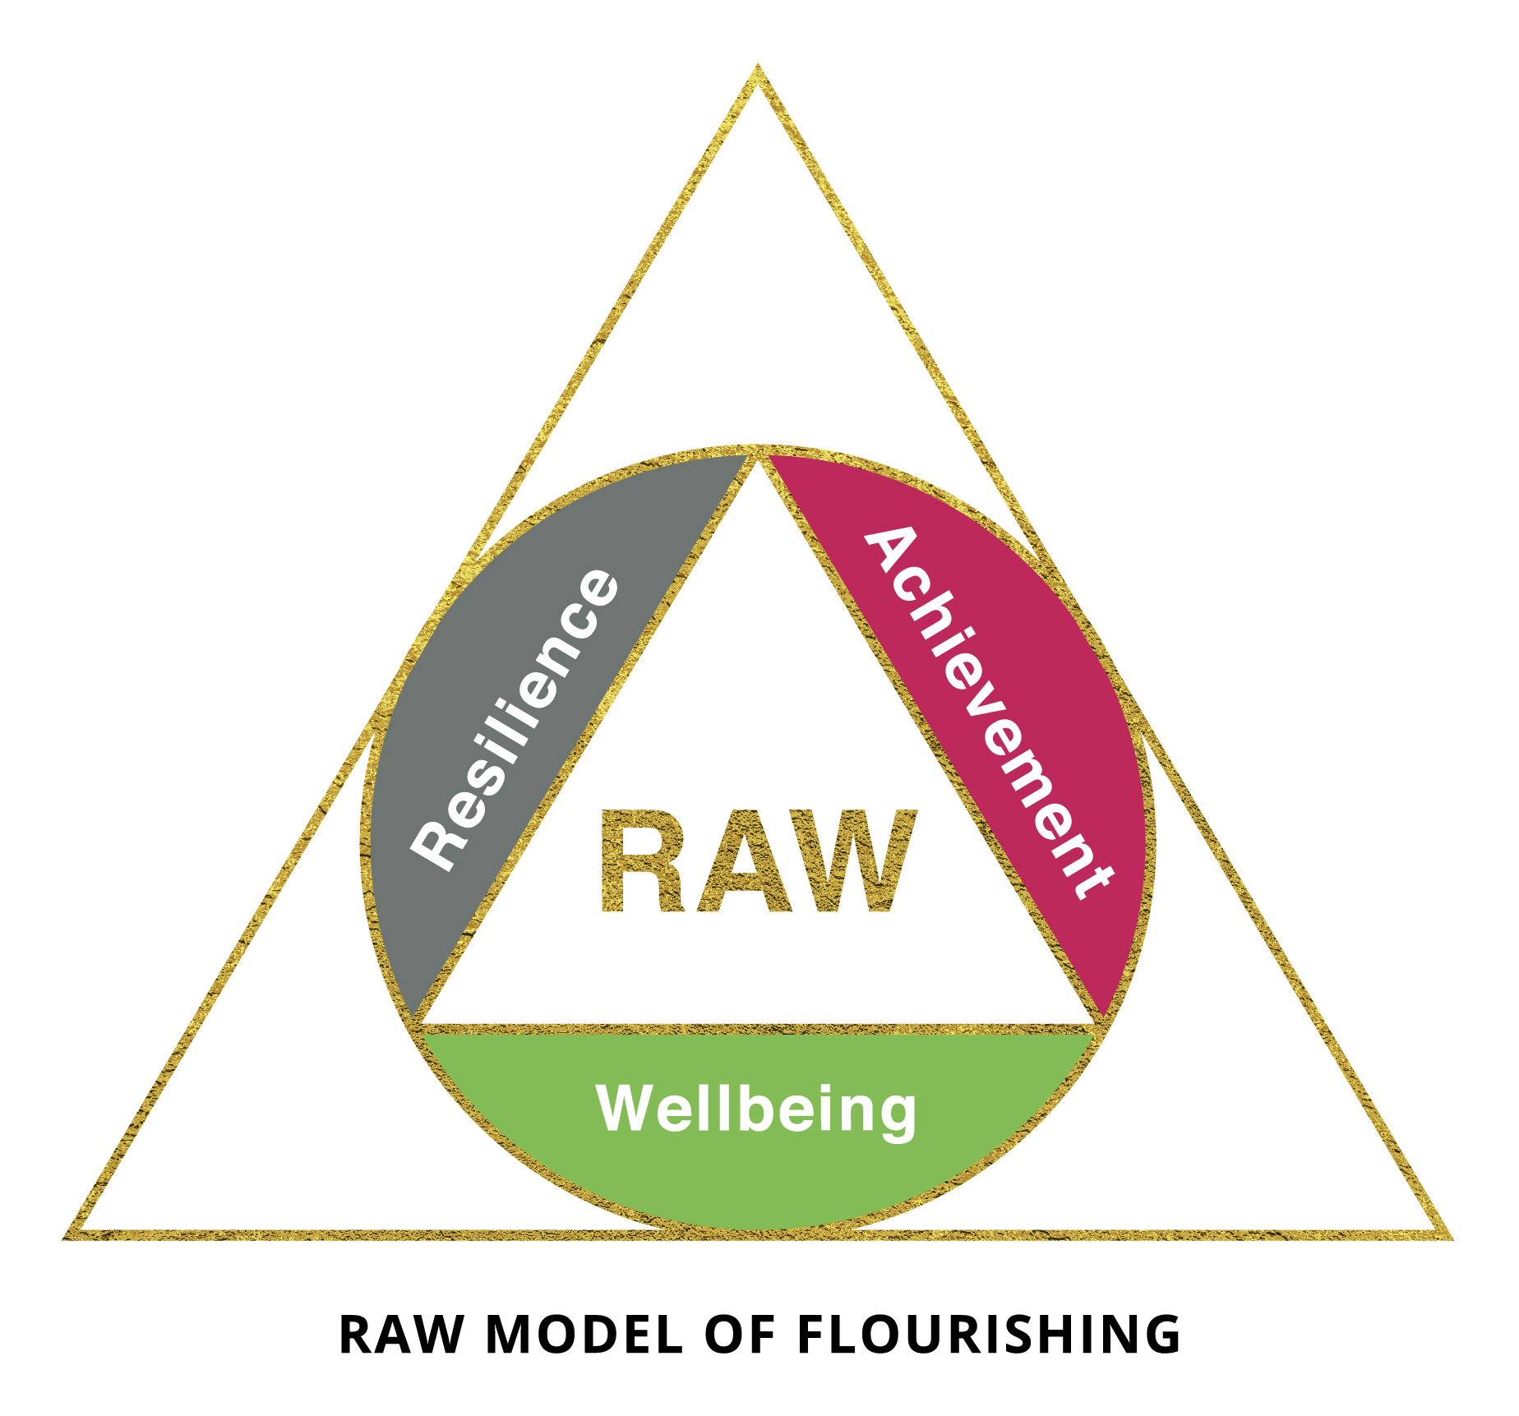
Pathways to help us flourish
Green & Palmer (2014)
www.PESA.edu.au © PESA 2018

Slide 4
What is Resilience?
Psychological resilience is defined by flexibility in response to changing situational demands, and the ability to bounce back from negative emotional experiences (Block & Kremen, 1996)
A multidimensional & dynamic psychological construct!
Resilience as a process and an outcome..
Many scholars consider psychological resilience to be both a trait and a state construct.
www.PESA.edu.au © PESA 2018

Slide 5
Resilience Interventions?
…a protective process by which one deliberately attempts to steer development in a more favourable direction…
Masten & Coatsworth, 1998
www.PESA.edu.au © PESA 2018

Slide 6
www.PESA.edu.au © PESA 2018

Slide 7

www.PESA.edu.au © PESA 2018

Slide 8
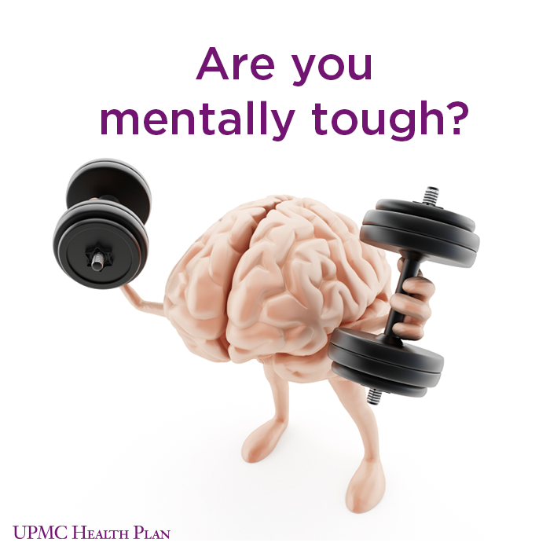
Mental Toughness
“A personality trait which significantly determines how individuals perform when exposed to stressors, pressure and challenge…irrespective of prevailing circumstances”
Clough & Strycharczyk, 2011
www.PESA.edu.au © PESA 2018

Slide 9
The case for mental toughness
Mental Toughness influences:
Performance –up to 25% of the variation in performance in individuals, achieve more, work harder
Positive Behaviour – more engaged, more positive, more “can do”, more likely to accept responsibility
Wellbeing – more contentment, better stress management , less prone to bullying
Aspirations – more ambitious, set higher standards, more confident, prepared to manage more risk
www.PESA.edu.au © PESA 2018

Slide 10
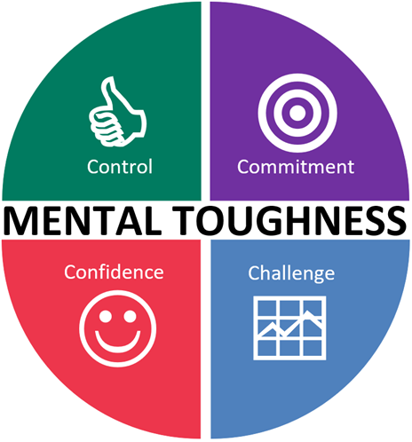
Mental Toughness Capacities
To become more resilient (or mentally tough) you need a blend of:
  Control – feeling you can manage whatever is happening within you and around you
  Commitment – desire to keep on going despite difficulties
  Challenge – stress is a normal part of life and a chance to learn and grow
  Confidence – belief you can successfully do things
www.PESA.edu.au © PESA 2018

Slide 11
The Four C’s of Mental Toughness
I really believe I can do it
I can keep my emotions in check when doing it
I promise to do it – I’ll set a goal
I’ll do what it takes to deliver it (hard work)
I am driven to do it – I will take a chance
Setbacks make me stronger
I believe I have the ability to do it
I can stand my ground if I need to
www.PESA.edu.au © PESA 2018

Slide 12
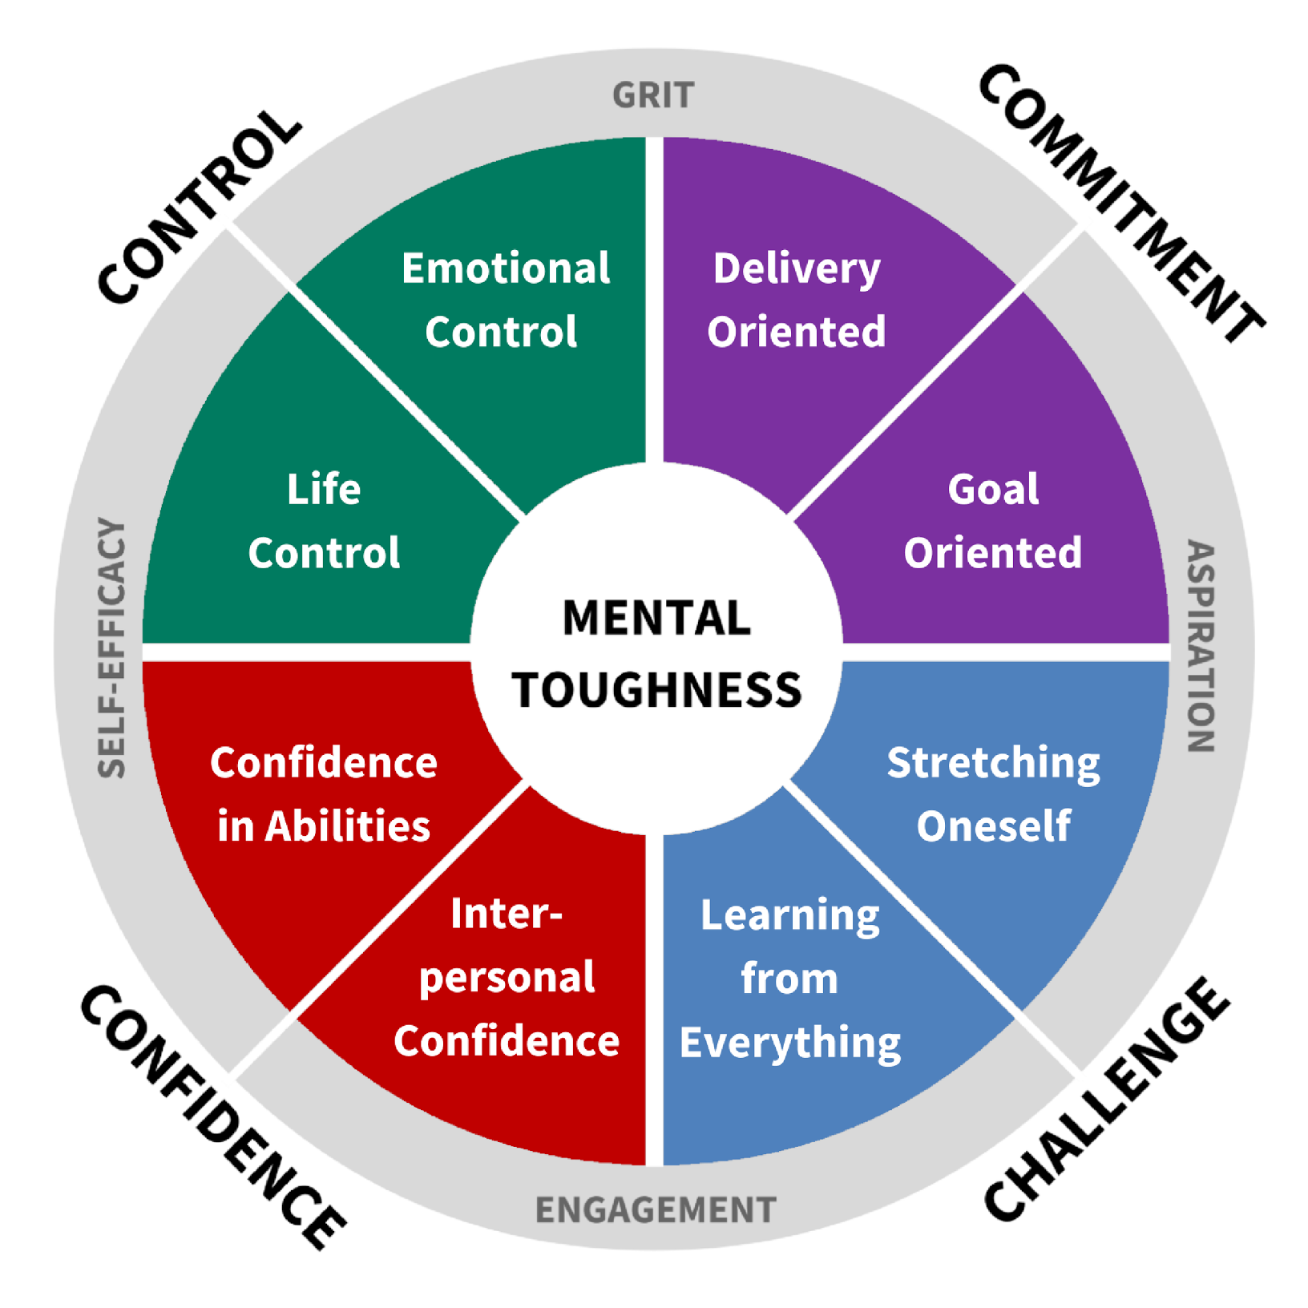
Factors of the 4C Model
www.PESA.edu.au © PESA 2018

Slide 13

MTQPlus
Measuring Mental Toughness
www.PESA.edu.au © PESA 2018

Slide 14
Mental Toughness Development
from where do the tools and techniques emerge?
Drawn from Clinical/Counselling Psychology, Sports Psychology/Coaching etc.
They all work ... But not for all tools are for all people!
New interventions are being developed and assessed – particularly to improve the ability to focus.
Technology helps. Biofeedback enables people to assess quickly and accurately what works and what doesn't.
www.PESA.edu.au © PESA 2018

Slide 15
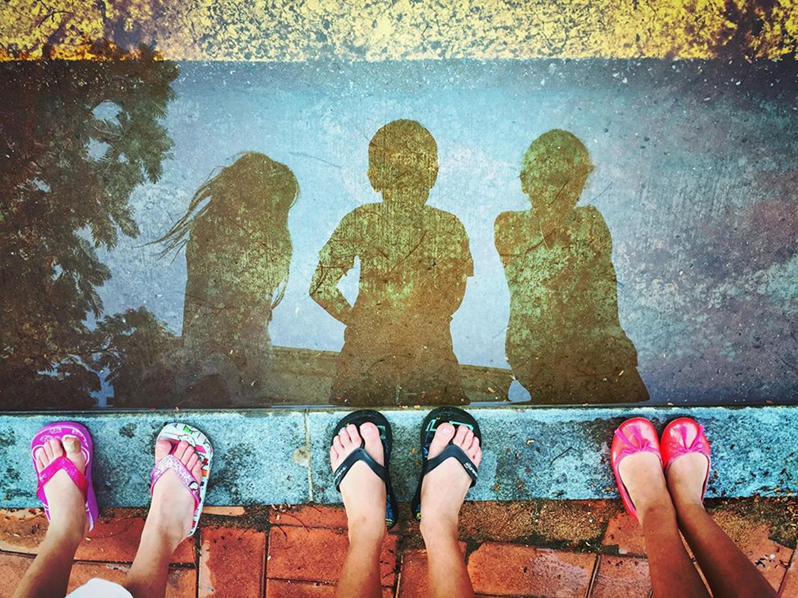


Developing Mental Toughness
Performance Thinking
Mindset + locus of control
Enhancing self talk
Prioritising positivity
Anxiety Management
Specific strategies to manage anxiety and stress
Attentional Control and mindfulness
Goal Setting and Coaching
Articulating and aligning values
Identifying and using strengths
Visualisation - Imagine
Completing MTQ48 to assess and understand and providing good feedback
Biofeedback
- Monitoring development
www.PESA.edu.au © PESA 2018

Slide 16
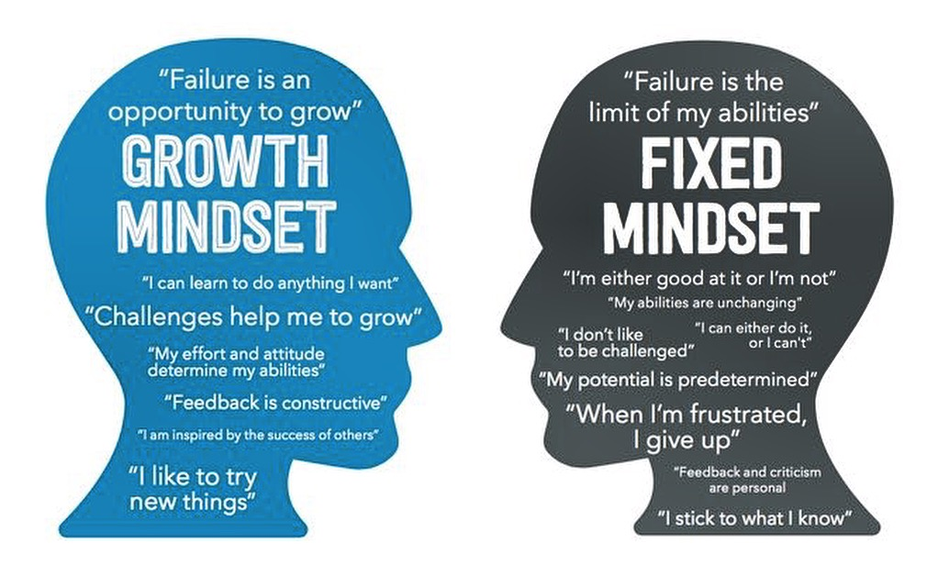
Remember…..
Mostly a mindset…
Low Mental Toughness equates to Mental Sensitivity (not Mental Weakness).
People with high Mental Toughness can cause problems
Individuals need the right level of Mental Toughness for the situation..
www.PESA.edu.au © PESA 2018

