Slide 1
Hearts & Minds
PESA Queensland Conference 2018

Slide 2
What will this workshop cover?
Why a new wellbeing framework at MBC?
Why Hearts & Minds? Where does this framework come from?
How will we apply the framework at MBC?
How was Hearts & Minds launched?
How will we measure the effectiveness of Hearts & Minds?
Notes:
Framed this presentation with these 5 questions:
Why a new wellbeing framework at MBC?
Why Hearts & Minds? Where does this framework come from?
How will we apply the framework at MBC – what will change and what will we need to do?
How was Hearts & Minds launched?
How will we measure the effectiveness of Hearts & Minds?
For some years now, the Pastoral Team has been investigating possible wellbeing frameworks and approaches to wellbeing
Although the feedback from stakeholders was that we were all doing great work pastorally, we saw a need to give what we were doing some structure – we wanted to avoid an ad-hoc approach and be confident that our programs were meeting the needs of the girls in terms of their wellbeing

Slide 3
Why a new wellbeing framework?
The concept of well-being comprises two main elements: feeling good and functioning well. Feelings of happiness, contentment, enjoyment, curiosity and engagement are characteristic of someone who has a positive experience of their life. Equally important for well-being is our functioning in the world. Experiencing positive relationships, having some control over one’s life and having a sense of purpose are all important attributes of wellbeing.
(New Economics Foundation, 2008)
Notes:
First and foremost, it was about student wellbeing
We recognised the importance of student wellbeing and the role it plays in setting them up to feel good and function well and, in turn, learn well
This is the definition that comes from the New Economics Foundation in the UK – an organisation that has done a lot of work around wellbeing
We were mindful that the elements of wellbeing that are included in this definition – experiencing positive emotions and relationships, having some control over one’s life and having a sense of purpose – all impact on a young person’s capacity to learn

Slide 4
Why a new wellbeing framework?
560 000 Australian children (1:7) have had a mental health condition in the previous 12 months
(Child & Adolescent Survey, 2015)
Up to 10% of Australian 14 & 15-year-olds self harm; up to 5% attempt suicide each year
(Australian Institute of Family Studies, 2017)
Half of all ‘adult’ mental health problems begin before the age of 14
(Kessler et al, 2005)
40% of parents report schools as the place that identifies a child might need support
(Child & Adolescent Survey, 2015)
Notes:
Mindful of the statistics around child and adolescent mental health in Australia
These types of statistics are a clarion call to promote wellbeing and explicitly teach wellbeing skills and schools are well-placed to influence their students’ wellbeing

Slide 5
Why a new wellbeing framework?
A wellbeing framework provides a platform for wellbeing education
Focuses on the tools and processes that promote good mental health
Aims to foster good wellbeing and prevent mental ill health
Notes:
A wellbeing framework provides a platform for wellbeing education and we see great value in teaching wellbeing skills
We knew that wellbeing education is a way to develop in our students tools and processes that promote good mental health and therefore buffer against mental ill health
It is not about fixing what is wrong with students – it is about being proactive rather than reactive

Slide 6
Why a new wellbeing framework?
Link between wellbeing and learning
…Student wellbeing is strongly linked to learning. A student’s level of wellbeing at school is indicated by their level of satisfaction at school, their engagement with learning and their social-emotional behaviour. It is enhanced when schools in partnerships adopt evidence-informed practice with families and the community. (Noble, 2008)
Wellbeing is the ‘oil of learning’. (Mann, 2006)
Wellbeing is not the destination but the nourishment for the learning journey. (Mann, 2006)
Notes:
The other reason why wellbeing is relevant to us is all to do with optimising learning outcomes
It’s a simple formula: healthy wellbeing equates with more effective learning and better outcomes – it’s impossible to separate the 2
Think about the anxious child or the tired teenager we see in our classrooms who aren’t engaging with their learning; the young girl who’s struggling to find a friendship group because she doesn’t have the social-emotional skills to build connections with her peers and teachers – they all face barriers to their learning

Slide 7
Why a new wellbeing framework?
OECD identifies teachers, schools and parents have a role to play in improving the wellbeing of 21st century children (Choi, 2018)
A need to align our approach to pastoral care with an evidence-based framework
A framework allows ongoing auditing of programs
Notes:
Knowing that we teachers, schools and parents have a role to play in improving the wellbeing of 21st century learners we saw a need to align our pastoral programs with an evidence-based framework
Having that framework keeps us honest – it allows for ongoing auditing of our programs to ensure they are effective in terms of optimising the girls’ wellbeing

Slide 8
Why Hearts & Minds?
Pastoral Team has been investigating possible wellbeing frameworks for some years – needed to fit MBC’s context
Explored Positive Education
2 criteria
Evidence-based
Alignment with MBC’s values and mission
2016 – investigated The 5 Ways to Wellbeing and developed a proposal

Slide 9
Why Hearts & Minds?
What is the The 5 Ways to Wellbeing?
A wellbeing framework developed by the UK’s New Economics Foundation (nef)
Involved the development of a set of 5 evidence-based actions that would improve personal wellbeing (i.e. help individuals feel better and function better)

Slide 10
Why Hearts & Minds?
What are the 5 actions?

Slide 11
Why Hearts & Minds?
Audits were conducted at MBC (in Primary and Secondary) and at MBBC
Programs such as HPE, RE, year level camps, service learning, PYP (Primary), PMP (in Secondary), House (Secondary) were evaluated in terms of the 5 actions.
Notes:
Audits were conducted at MBC (in Primary and Secondary) and at MBBC
Programs such as HPE, RE, year level camps, service learning, PYP (Primary), PMP (in Secondary), House (Secondary) were evaluated in terms of the 5 actions
Year 6-12 students completed surveys which asked a series of questions using the language of The Five Ways to Wellbeing and were also given the opportunity to provide qualitative data
Results indicated that the 5 actions were already embedded in our approach to pastoral care and student wellbeing, but showed there were areas that needed further development

Slide 12
Why Hearts & Minds?
5 Ways to Wellbeing | Year 7 PMP | Year 7 HPE | House experience | Year 7 RE & Service learning | Year 7
Connect
Be Active
Take Notice
Keep Learning
Give

Slide 13
Why Hearts & Minds?
5 Ways to Wellbeing | Year 7 PMP | Year 7 HPE | House experience | Year 7 RE & Service learning | Year 7 Camp
Connect | Sense of belonging Recognising emotions |  | Vertical form structure – Form and House activities working across all year levels 7- 12 Year 7 and Year 11 IYC in each form – big sister relationship | RE classes are open, inquiry based classes where big philosophical questions are pondered in an open and supportive environment. | Year 7s in randomly mixed groups during the day – House groups in the evening – friendship groups for sleeping cabins.
Be Active |  | Dimensions of health Health trends Physical health Swimming Health related fitness components FITT Principles Fitness testing | Interhouse Swimming Interhouse Cross Country Interhouse Athletics Treasure Hunts – Dance off - Musical Extravaganza dance component for all girls in each year level |  | Rafting Flying Fox Orienteering Hike Giant swing

Slide 14
Why Hearts & Minds?
5 ways to wellbeing | Give | Be Active | Take Notice | Keep Learning | Connect
PYP Learner profile | Caring | Balanced | Knowledgeable, inquirers | Thinkers, reflective, courageous | Communicators, principled, open minded
PYP Attitudes | Appreciation, empathy, tolerance |  | Enthusiasm, curiosity, | Confidence, commitment, integrity, independence | Creativity Cooperation, respect
P-3 | Kids Matter Service Learning Anti bullying actions Random Actions wall Walk for Others Easter Egg donations Empty Christmas Tree Birthday book or sponsor child donations Acknowledgements at assembly | Yr 1-3 swim carnival P-3 athletics Yr 3 camp Andrews Cup events Move to Learn Co-curricular activities | You Can Do It Cyber safety education SMACK 3 way and student led conferences Greene-ware | You Can Do It Chapel services Social/emotional testing Optional external testing | Kids Matter You Can Do It Class buddies Essential agreements Excursions/incursions Assemblies Choirs and ensembles

Slide 15
Why Hearts & Minds?
 | P - 3 | 4 - 6 | 7 | 8 | 9 | 10 | 11 | 12
Connect | + | + | + | + | + | + ? | + | +
Be active | + | + | + | + | + | + | + ? | +
Take notice | + | + | + ? | + ? | + ? | + ? | + ? | + ?
Keep learning | + | + | + | + | + | + | + | +
Give | + ? | + ? | + ? | + ? | + ? | + ? | + ? | + ?

Slide 16
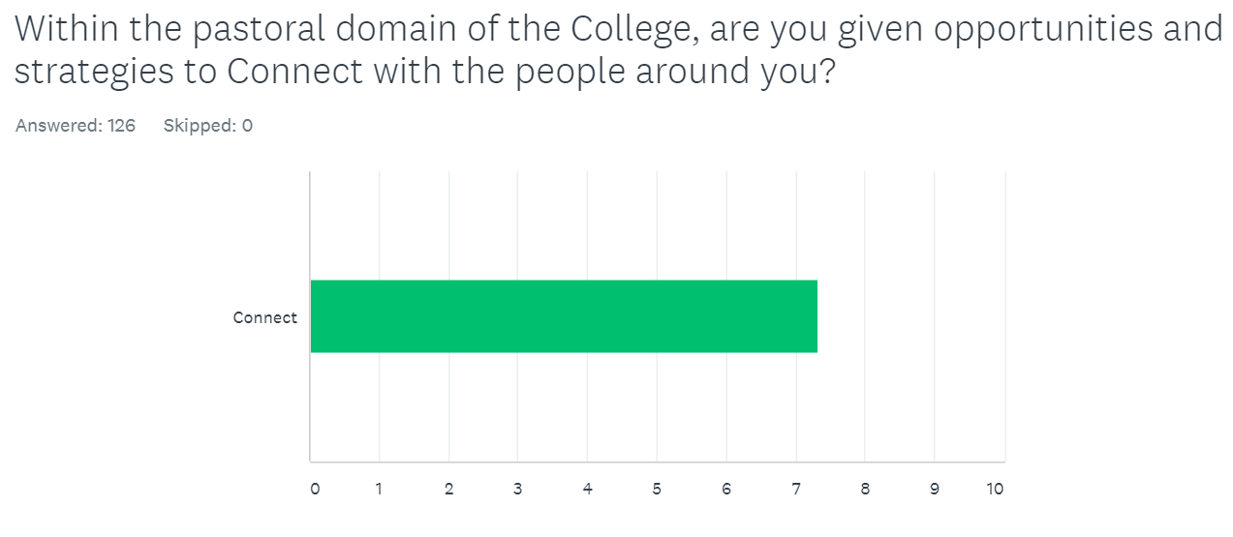
Why Hearts & Minds?
A random sample of Year 7-11 students (P = 126) completed surveys which asked a series of questions using the language of The Five Ways to Wellbeing

Slide 17
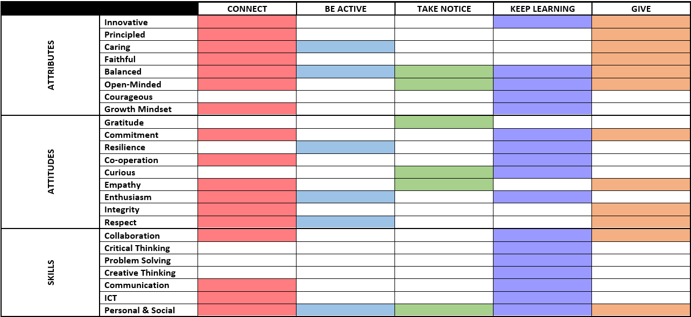
Why Hearts and Minds?
Notes:
Along with the auditing process, we’ve also recently mapped the 5 actions against the Graduate Attributes, Attitudes and Skills
This was about asking the question: If these are the things we want our graduates to leave our Colleges with, then how can they be fostered through our wellbeing framework?
The shaded cells show how different attributes, attitudes and skills are represented in each of the 5 actions - each one is represented in at least 1 of the 5
How we approached this was to take each of the attributes (e.g. caring) and ask: Which of the 5 actions allows for that attribute to be developed?
For example: the attribute or principled could be developed through connecting with and giving to others
Likewise, by taking notice and learning new things, the attitude of curiosity would be developed

Slide 18
Why Hearts & Minds?
Results indicated that the 5 actions were already embedded in our approach to pastoral care and student wellbeing.
However, it also showed there were areas that needed further development.

Slide 19
How will we apply the framework?
No change to our approach, but we will continue to evaluate our pastoral work and our wellbeing programs
5 Ways to Wellbeing will overlay current approach and be called Hearts & Minds
Hearts & Minds comes from our tagline: Breadth of mind. Depth of heart.
The 5 actions will be explored in pastoral programs (e.g. PYP, PMP, House, Service Learning)
Notes:
No change to our approach, but we will continue to evaluate our pastoral work and our wellbeing programs – to ensure they are current and fresh and ‘hitting’ the 5 actions
5 Ways to Wellbeing will overlay current approach and be called Hearts & Minds
Hearts & Minds comes from our tagline: Breadth of mind. Depth of heart.
In terms of the girls, we have launched this in secondary at Assembly in week 7 – important that it came from the girls themselves, so we had the College Captains take responsibility for the launch
This week during PMP lessons, all secondary girls will complete a personal audit and an online survey
Applying the framework will be about exploring the 5 actions in pastoral programs and looking for opportunities to embed them in activities and routines, with the ultimate goal being to optimise the girls’ wellbeing

Slide 20
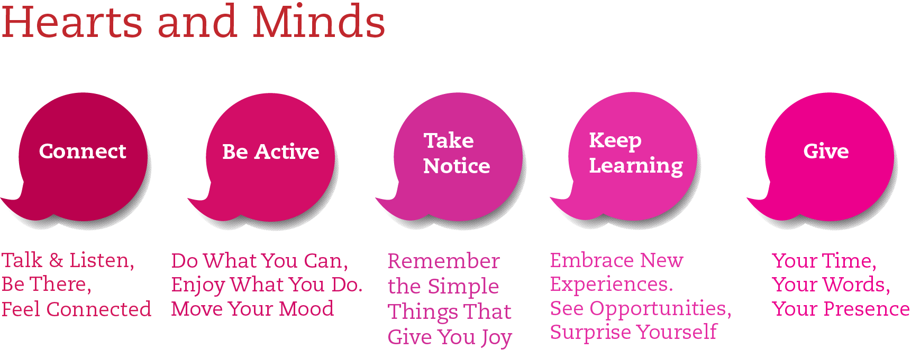
How will we apply the framework?
Notes:
What does our version of the 5 Ways to Wellbeing look like?

Slide 21
How was Hearts & Minds launched?
Presentation to staff at staff meeting
To students from students (the College Captains) at an Assembly presentation
Letter to parents
Presentation to parents at Parent Forum
Newsletter article, bookmarks and poster

Slide 22
What about staff wellbeing?
Staff wellbeing audit
Feedback from staff about ideas to foster staff wellbeing
Staff Wellbeing Committee was started
Notes:
We’re very aware that for students to learn skills of wellbeing, they need to teachers who are equipped to teach those skills
With that in mind, we recognise the importance of staff wellbeing
At the PESA National Conference in Melbourne in April, the overriding message was about the importance of starting with staff wellbeing when implementing a wellbeing framework

Slide 23
How will we measure the effectiveness of Hearts & Minds?
Student wellbeing - ACER SEW Survey
Exploring a partnership with University of Adelaide and other methods of measuring student wellbeing and teacher wellbeing

Slide 24
How does Hearts & Minds align with policy and procedures?
Hearts and Minds
Five Ways to Wellbeing
Positive Behaviours Policy and Procedure (MBC)
Anti Bullying Strategy
Network User Agreement
College Behaviour Expectations
Mental Health Strategy
Mobile Phone Procedures
Notes:
An attempt to demonstrate the alignment
Where does this all fit in?
Explain what the pastoral teams have been doing.

Slide 25
Hearts & Minds
When educating the minds of our youth,
we must not forget to educate their hearts
- Dalai Lama

