Slide 1


Creating Engaging Personalized Resources for Positive Education Classrooms
Juliette Bentley
Classroom Teacher
BA, GradDipSecTeach, M.Ed, Adobe Campus Leader.
@BentleyJuliette
jbentley@msm.qld.edu.au
www.PESA.edu.au © PESA 2018

Slide 2

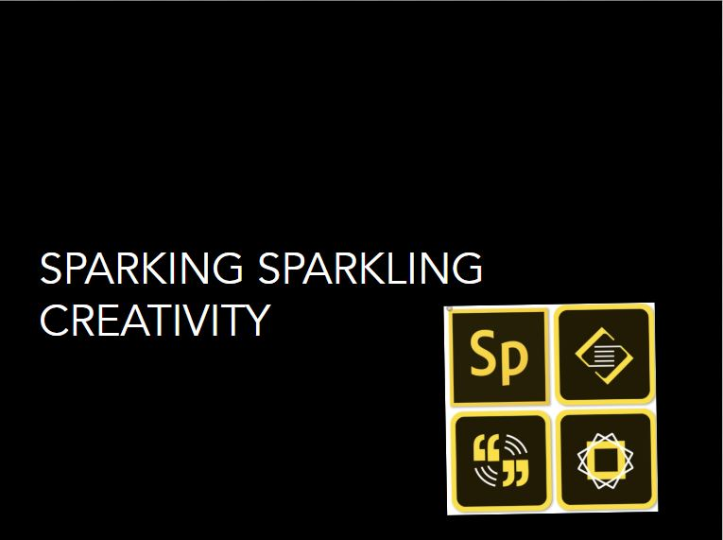
www.PESA.edu.au © PESA 2018

Slide 3
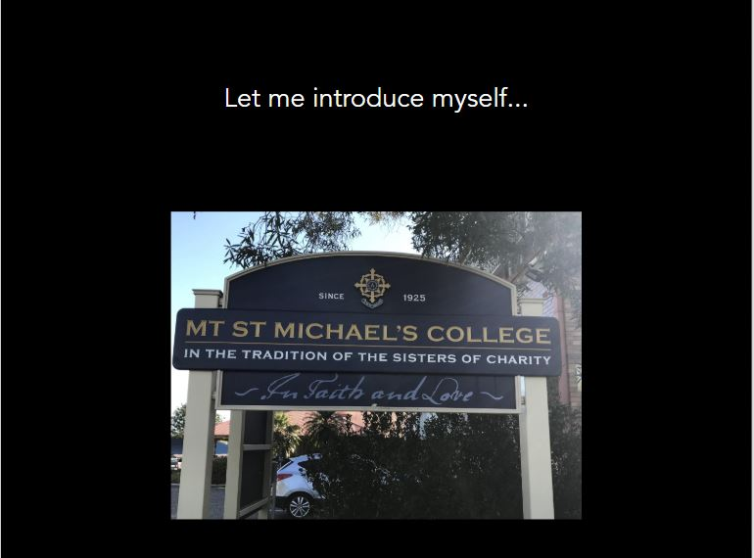

www.PESA.edu.au © PESA 2018

Slide 4

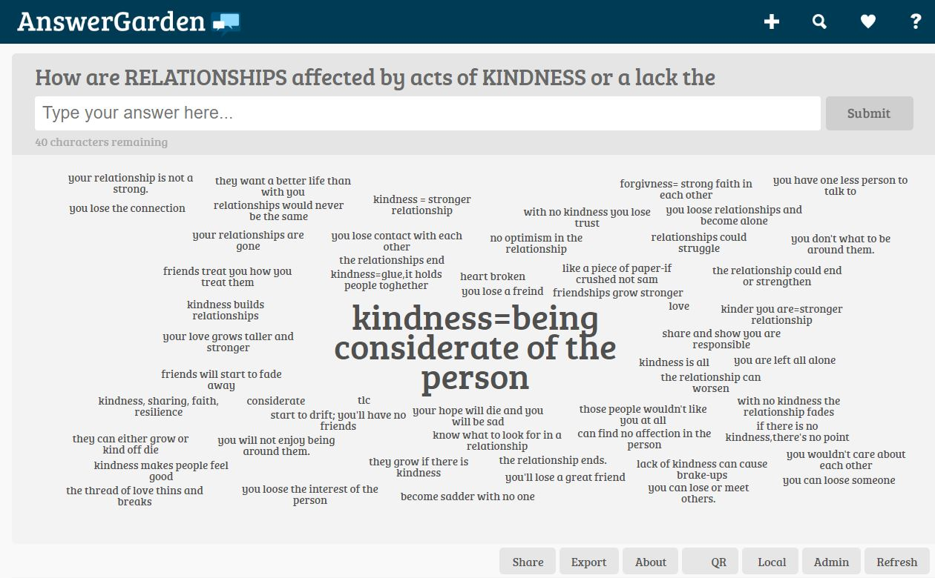
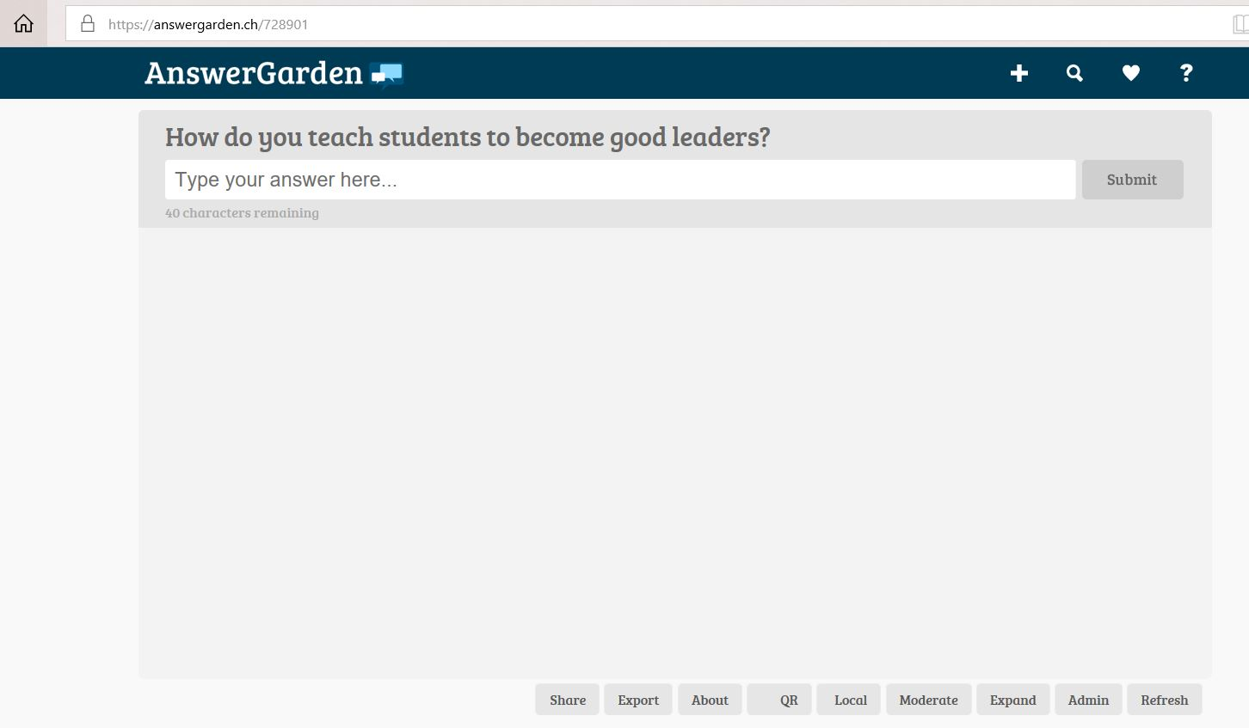
Introducing Answer Garden
Grade 7 students responding anonymously to a question posed.
Now it is your turn. Go to https://answergarden.ch/728901
Password: PESA
www.PESA.edu.au © PESA 2018

Slide 5

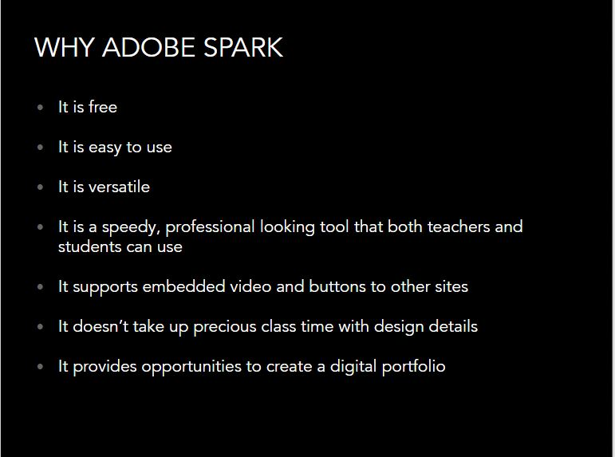
www.PESA.edu.au © PESA 2018

Slide 6

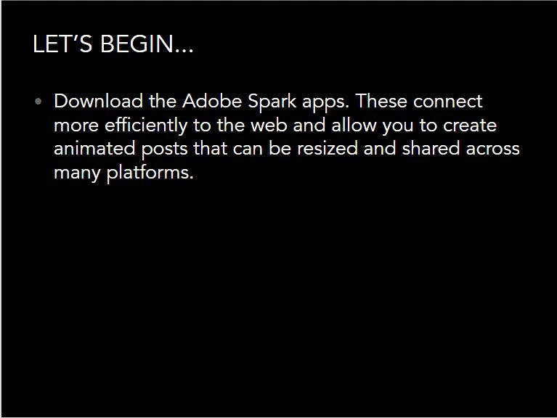
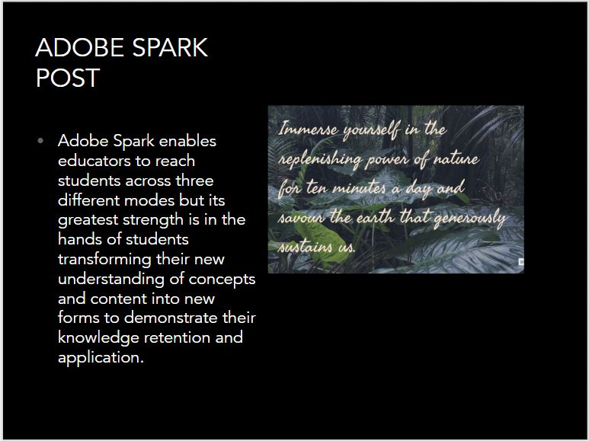
www.PESA.edu.au © PESA 2018

Slide 7
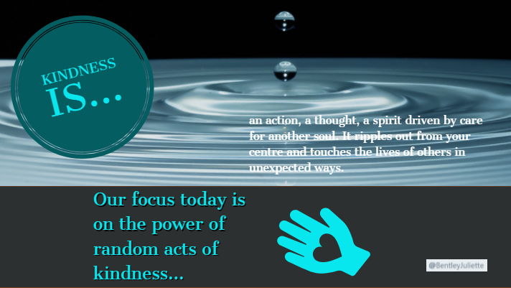
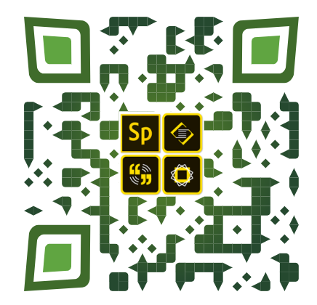
Adobe Spark Login
www.PESA.edu.au © PESA 2018

Slide 8
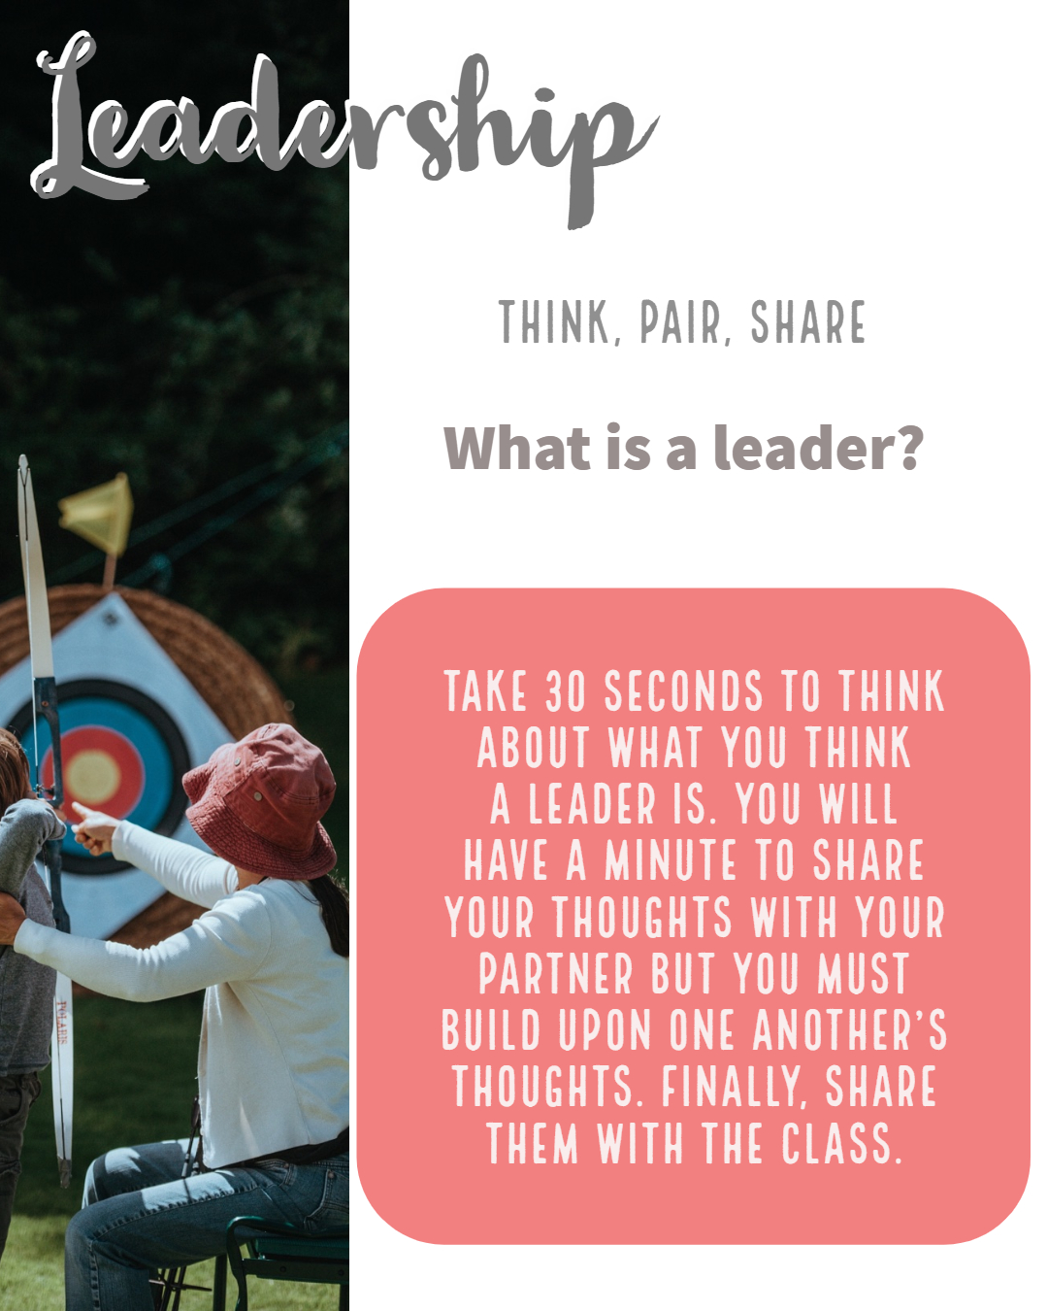
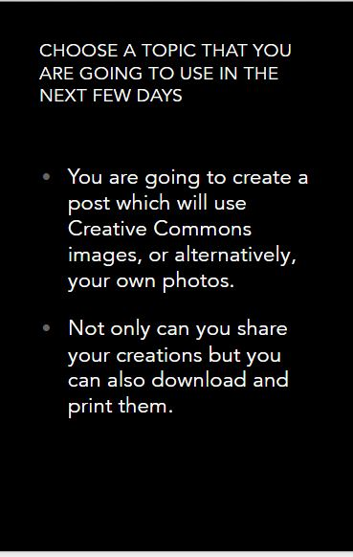

www.PESA.edu.au © PESA 2018

Slide 9
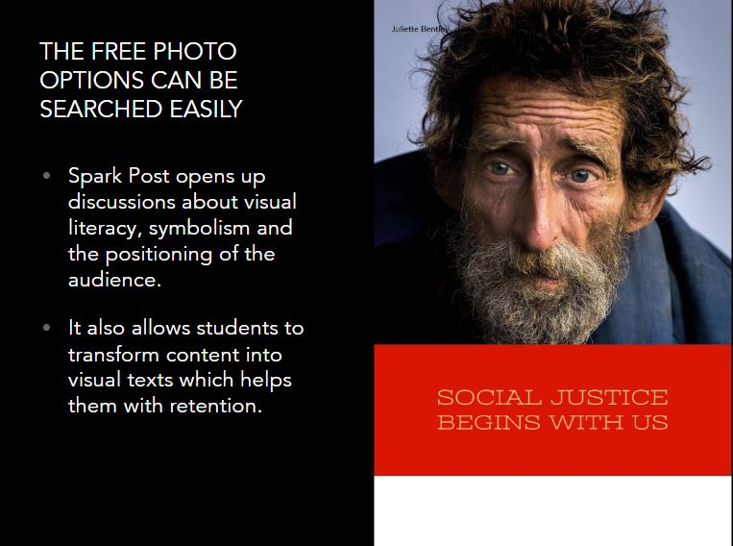
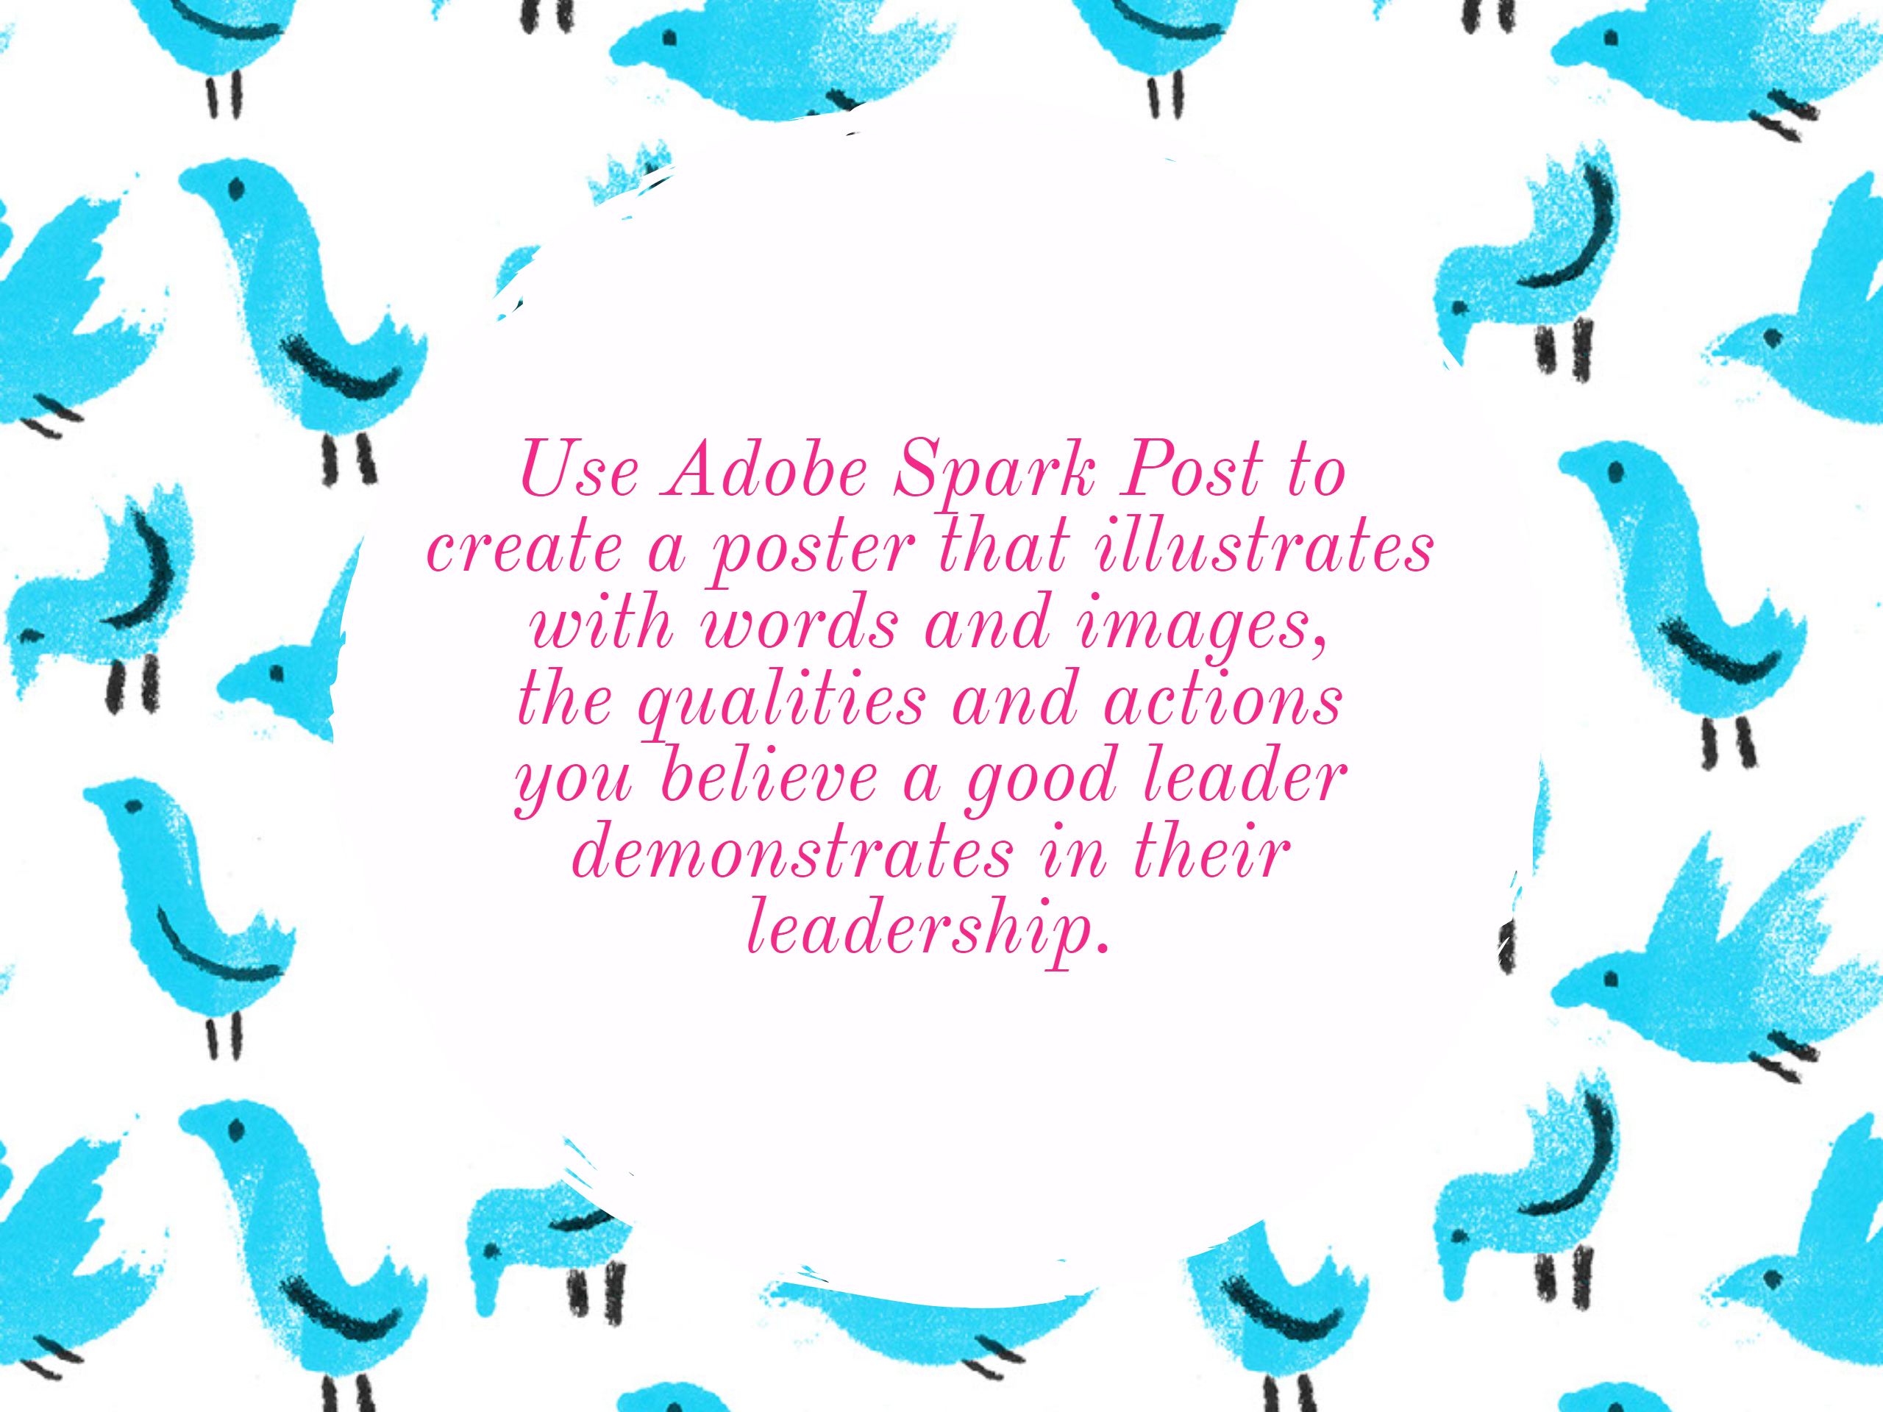
Examples of Spark Post used in Pos Ed
www.PESA.edu.au © PESA 2018

Slide 10
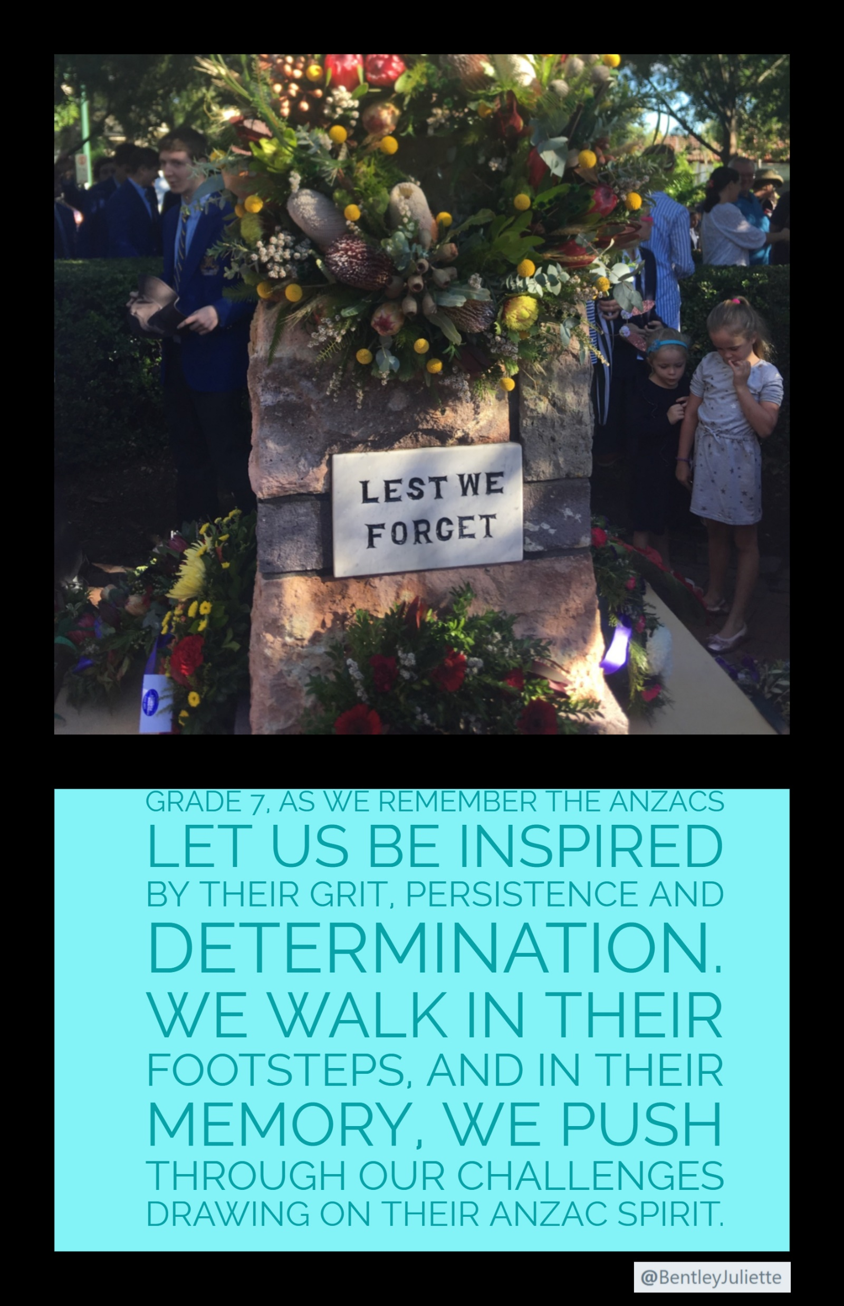

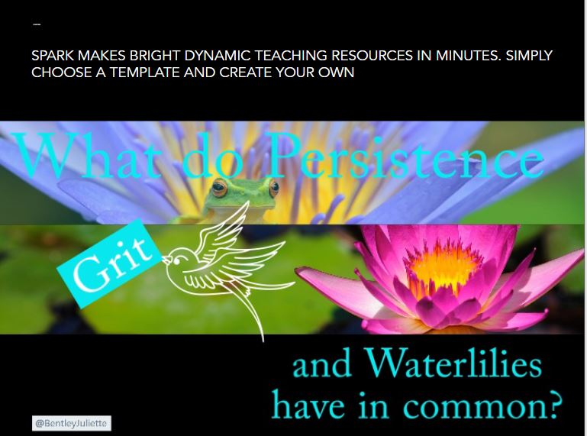
Now you have a go at making a post or two.
www.PESA.edu.au © PESA 2018

Slide 11
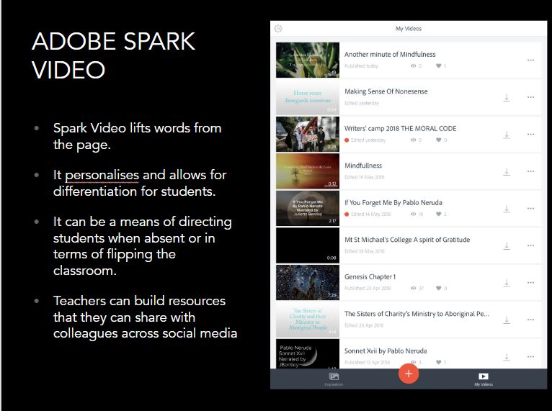

Adobe Spark Videos are a fabulous way to engage with your students, and the power of a familiar voice, particularly out of the didactic context students usually hear you speaking to them in, can be powerful.
www.PESA.edu.au © PESA 2018

Slide 12
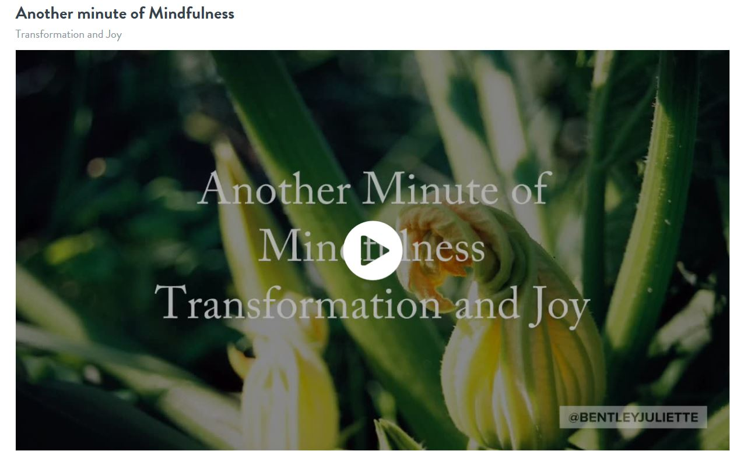
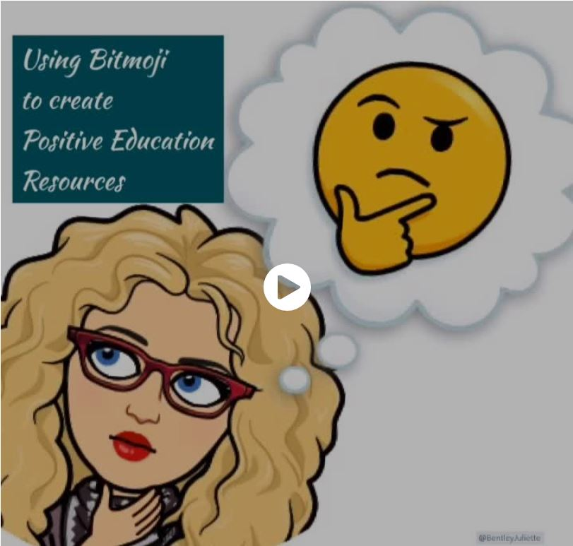

Let us look at Adobe Spark Video
Transformation
Spark Video is fabulous because it allows you to not only use your own photos as well as Creative Commons images, but you can also create your slides in Post, customising them to suit your audience.
The example below illustrates how I used Bitmoji in Adobe Post, to create slides for Adobe Spark Video.
Bitmoji in Positive Education
Now it is your turn
www.PESA.edu.au © PESA 2018

Slide 13
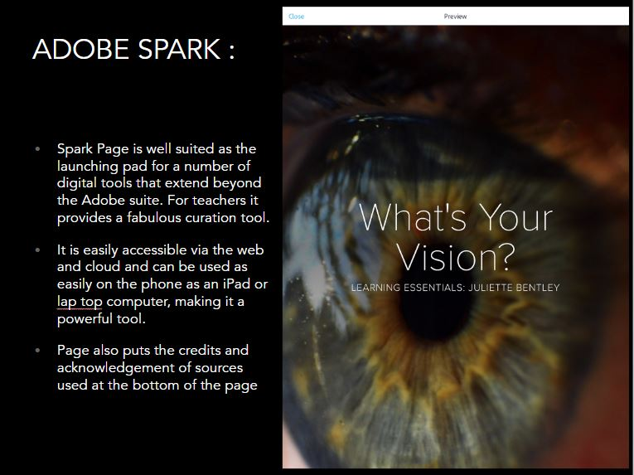

Try Adobe Spark Pages
www.PESA.edu.au © PESA 2018

Slide 14
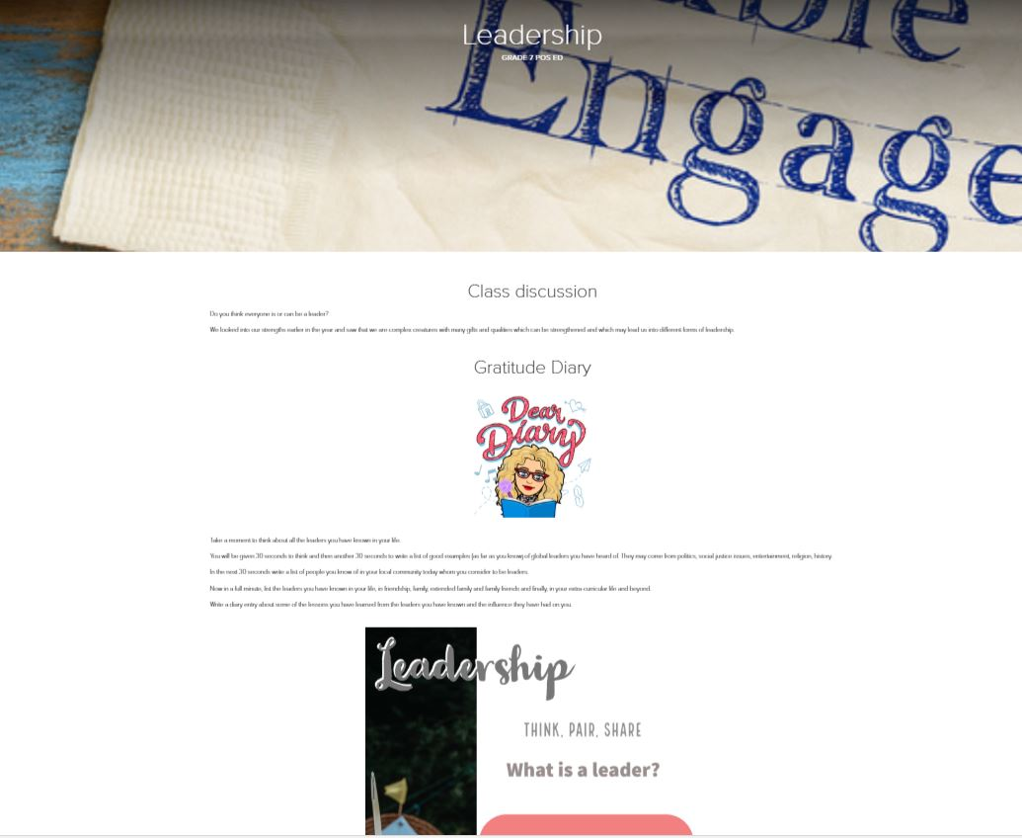

https://spark.adobe.com/page/CRTwkOKawfcWM/
Let’s have a look at how we can bring our artefacts together…
www.PESA.edu.au © PESA 2018

Slide 15
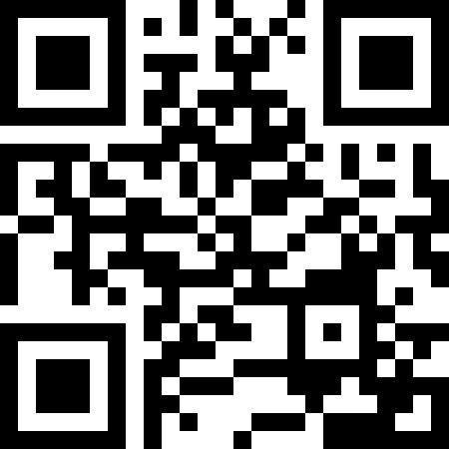

Introducing Flipgrid
Flipgrid provides boundless opportunities for students to respond to rich questions, build confidence in their own capacity to communicate their opinions and respond to one another.
Flipgrid URL for those unable to connect otherwise:
Flip Grid Code: https://flipgrid.com/ba562f
Password:
PositiveEducation
www.PESA.edu.au © PESA 2018

Slide 16

So far today you have:
Created an Adobe Spark Post
Created an Adobe Spark Video
Created an Adobe Spark Page and inserted your video and Spark Post into it
Hopefully we have also looked at Flipgrid and Answer Garden
Shared ideas, connected and hopefully developed your PLN a little further
Consider using Twitter as part of your PLN. Sharing ideas and resources can be great stimuli for tailoring of materials for your own clientele.
www.PESA.edu.au © PESA 2018

Slide 17

Drop me a line
jbentley@msm.qld.edu.au
Twitter: @BentleyJuliette
www.PESA.edu.au © PESA 2018

