Slide 1
To Feedback or to Withhold?
Notes:
Allow 20 minutes

Slide 2
Overview
What are the concerns if feedback is given to students?
What are potential consequences of not providing feedback to students?
Benefits of providing feedback to students
Tips for providing feedback

Slide 3
Concerns if feedback is given
Cause harm to individuals with poor wellbeing
Concern over students comparing results with peers
Concern over individual being compared to a norm group
Data privacy concerns if individual names are linked to survey responses
Might change how they respond knowing results aren’t anonymous and low results my prompt a visit to the school psychologist

Slide 4
Concerns if feedback is withheld
No feedback may reduce “buy in”
May reduce likelihood of providing honest responses
Parents may feel they have a right to know their child’s results (who owns the data?)

Slide 5
Benefits of providing feedback
Increase student awareness of “what matters” in relation to wellbeing (increase literacy)
Increase self-awareness
Increase motivation to improve wellbeing
Can link to goal setting
Can give students a sense of accomplishment if they observe measurable improvements from one survey to the next

Slide 6
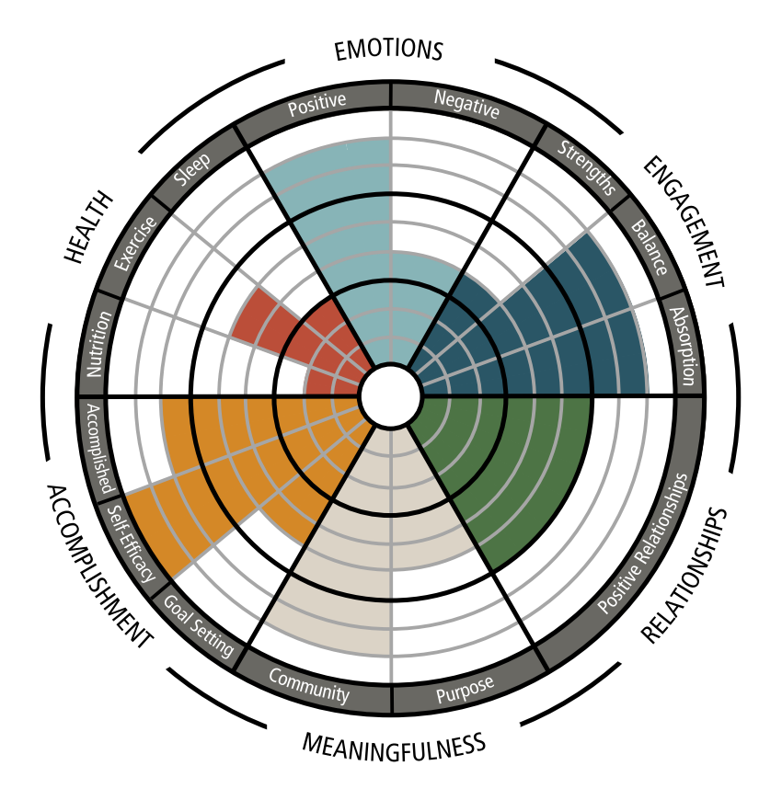
What does the FP survey measure?
Positive Health
Nutrition
Exercise
Sleep
Emotions
Positive Emotions
Negative Emotions
Accomplishment
Goal Setting
Self-Efficacy/Resilience
Accomplished
Engagement
Strengths Known
Balance
Absorption (Flow)
Meaningfulness
Purpose
Community
Positive Relationships
Mutual trust and Enjoyment

Slide 7
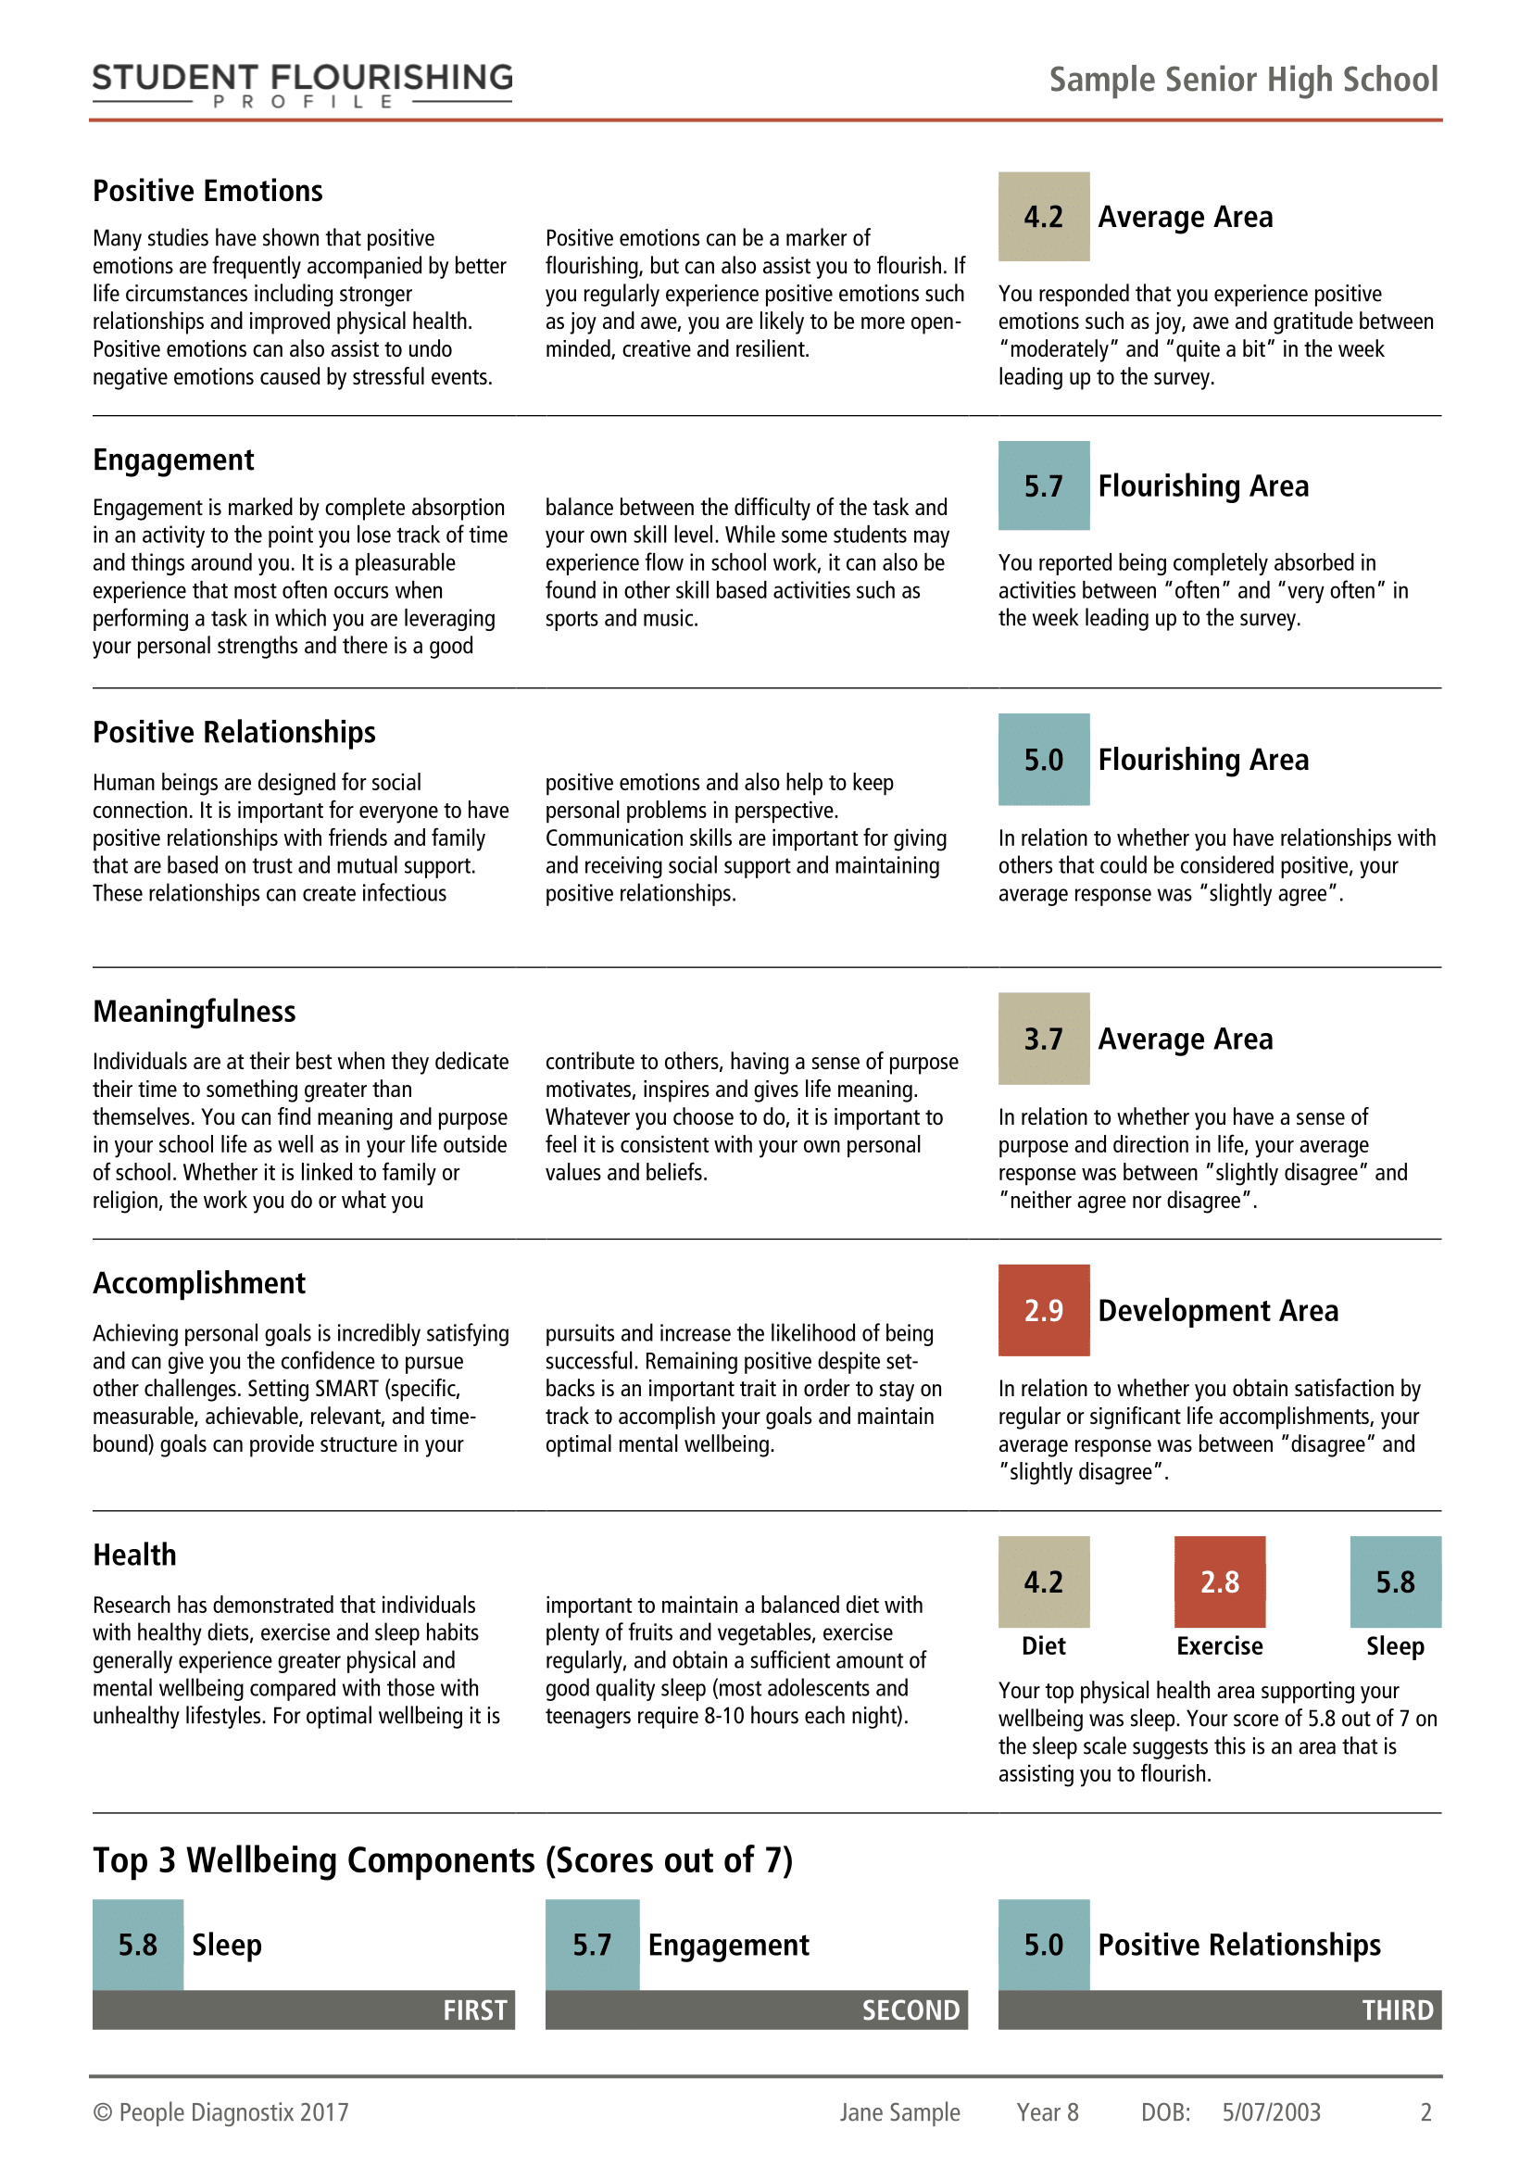
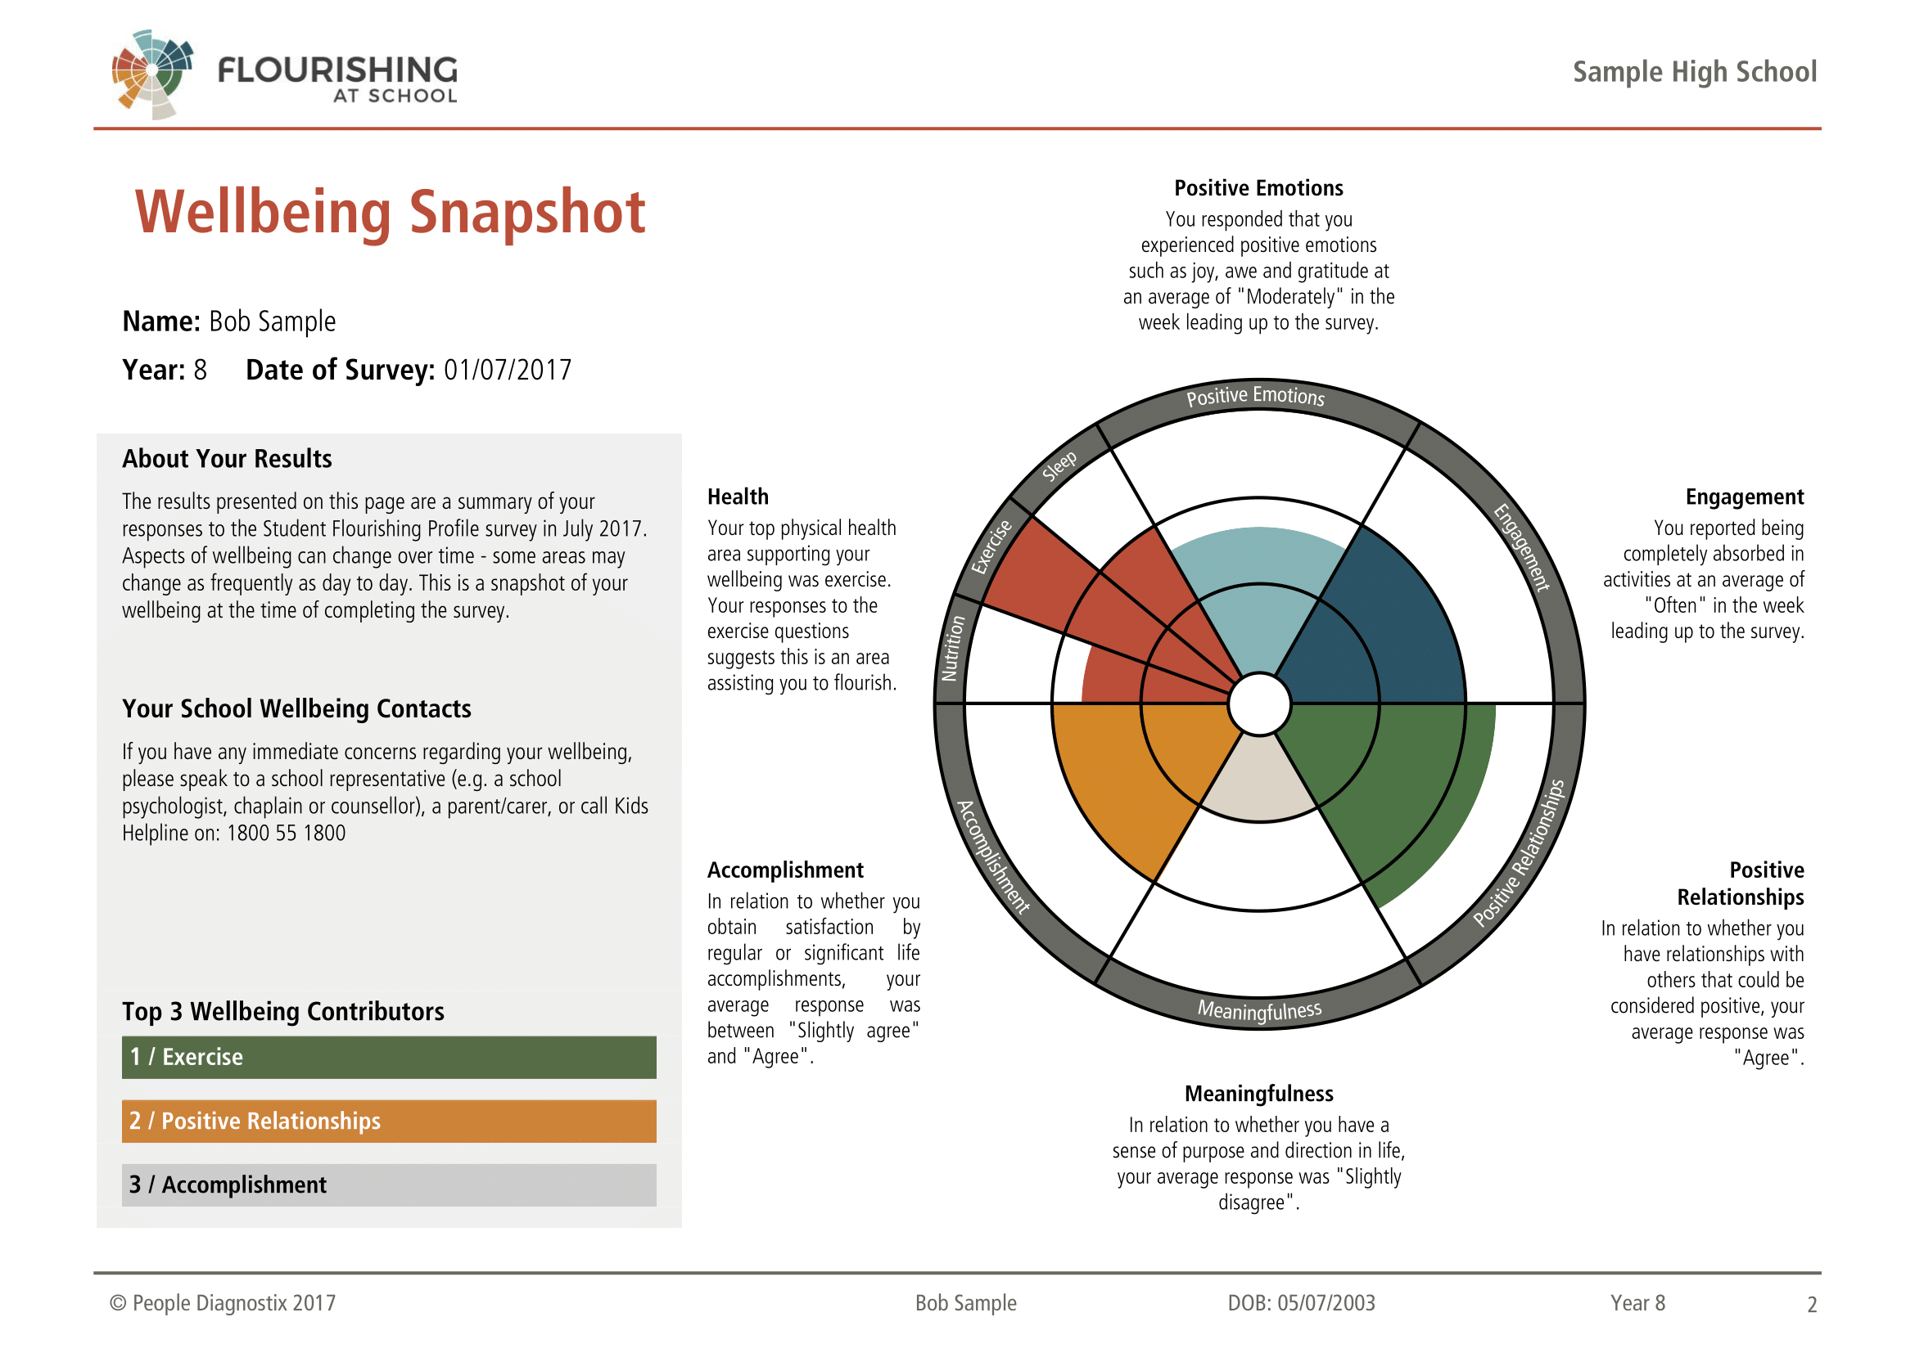
Feedback report design process

Slide 8
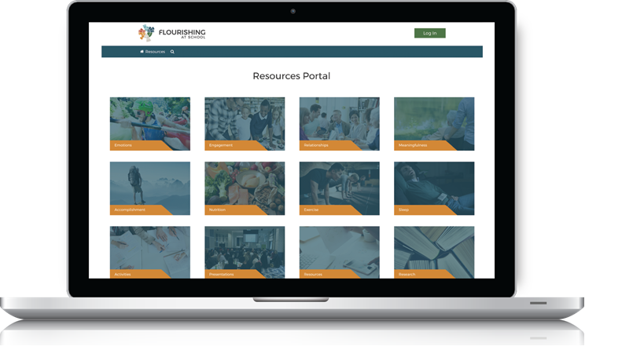
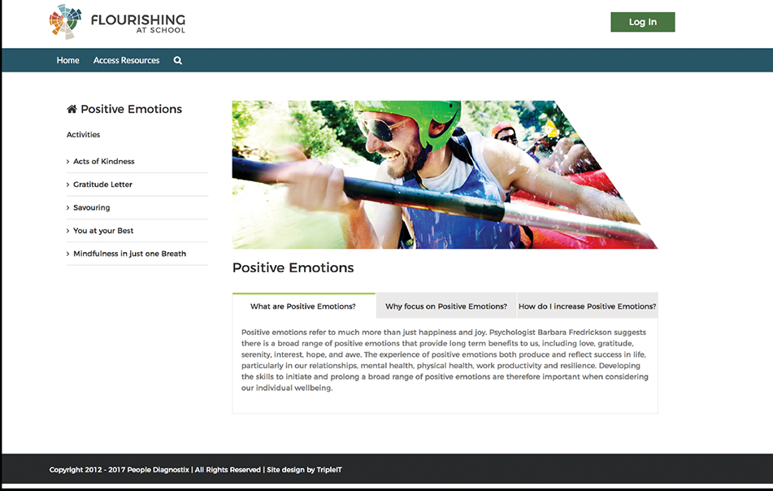
Self-development resources

Slide 9
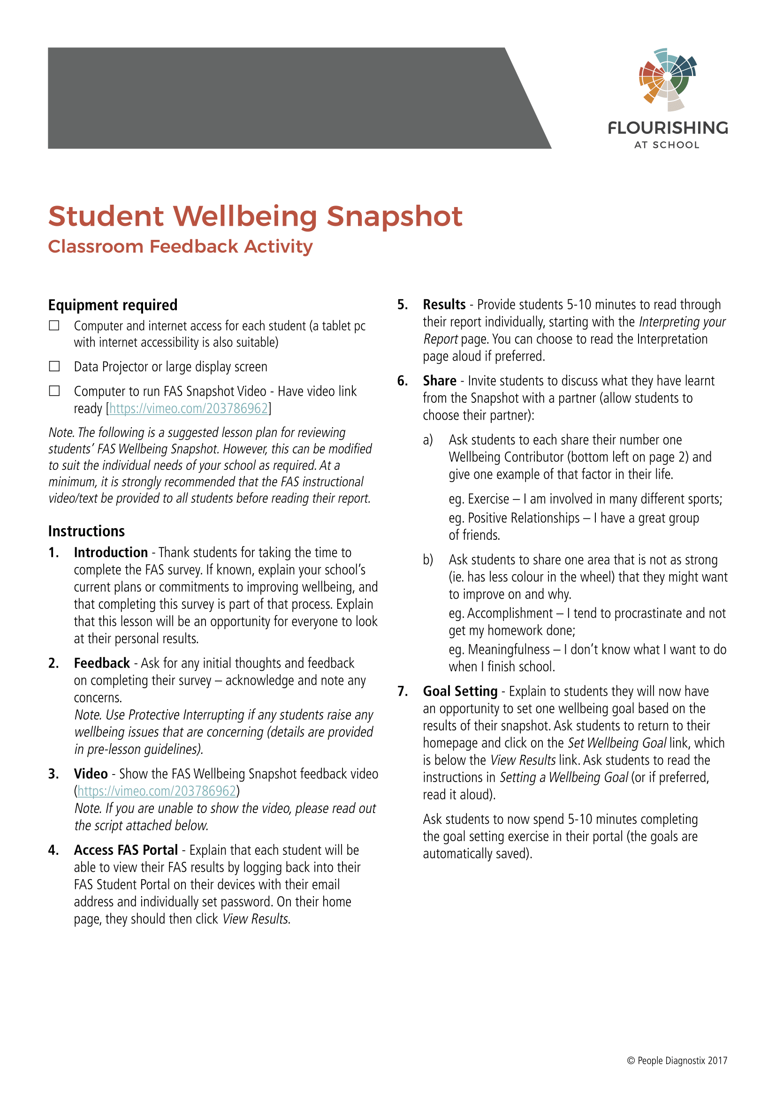
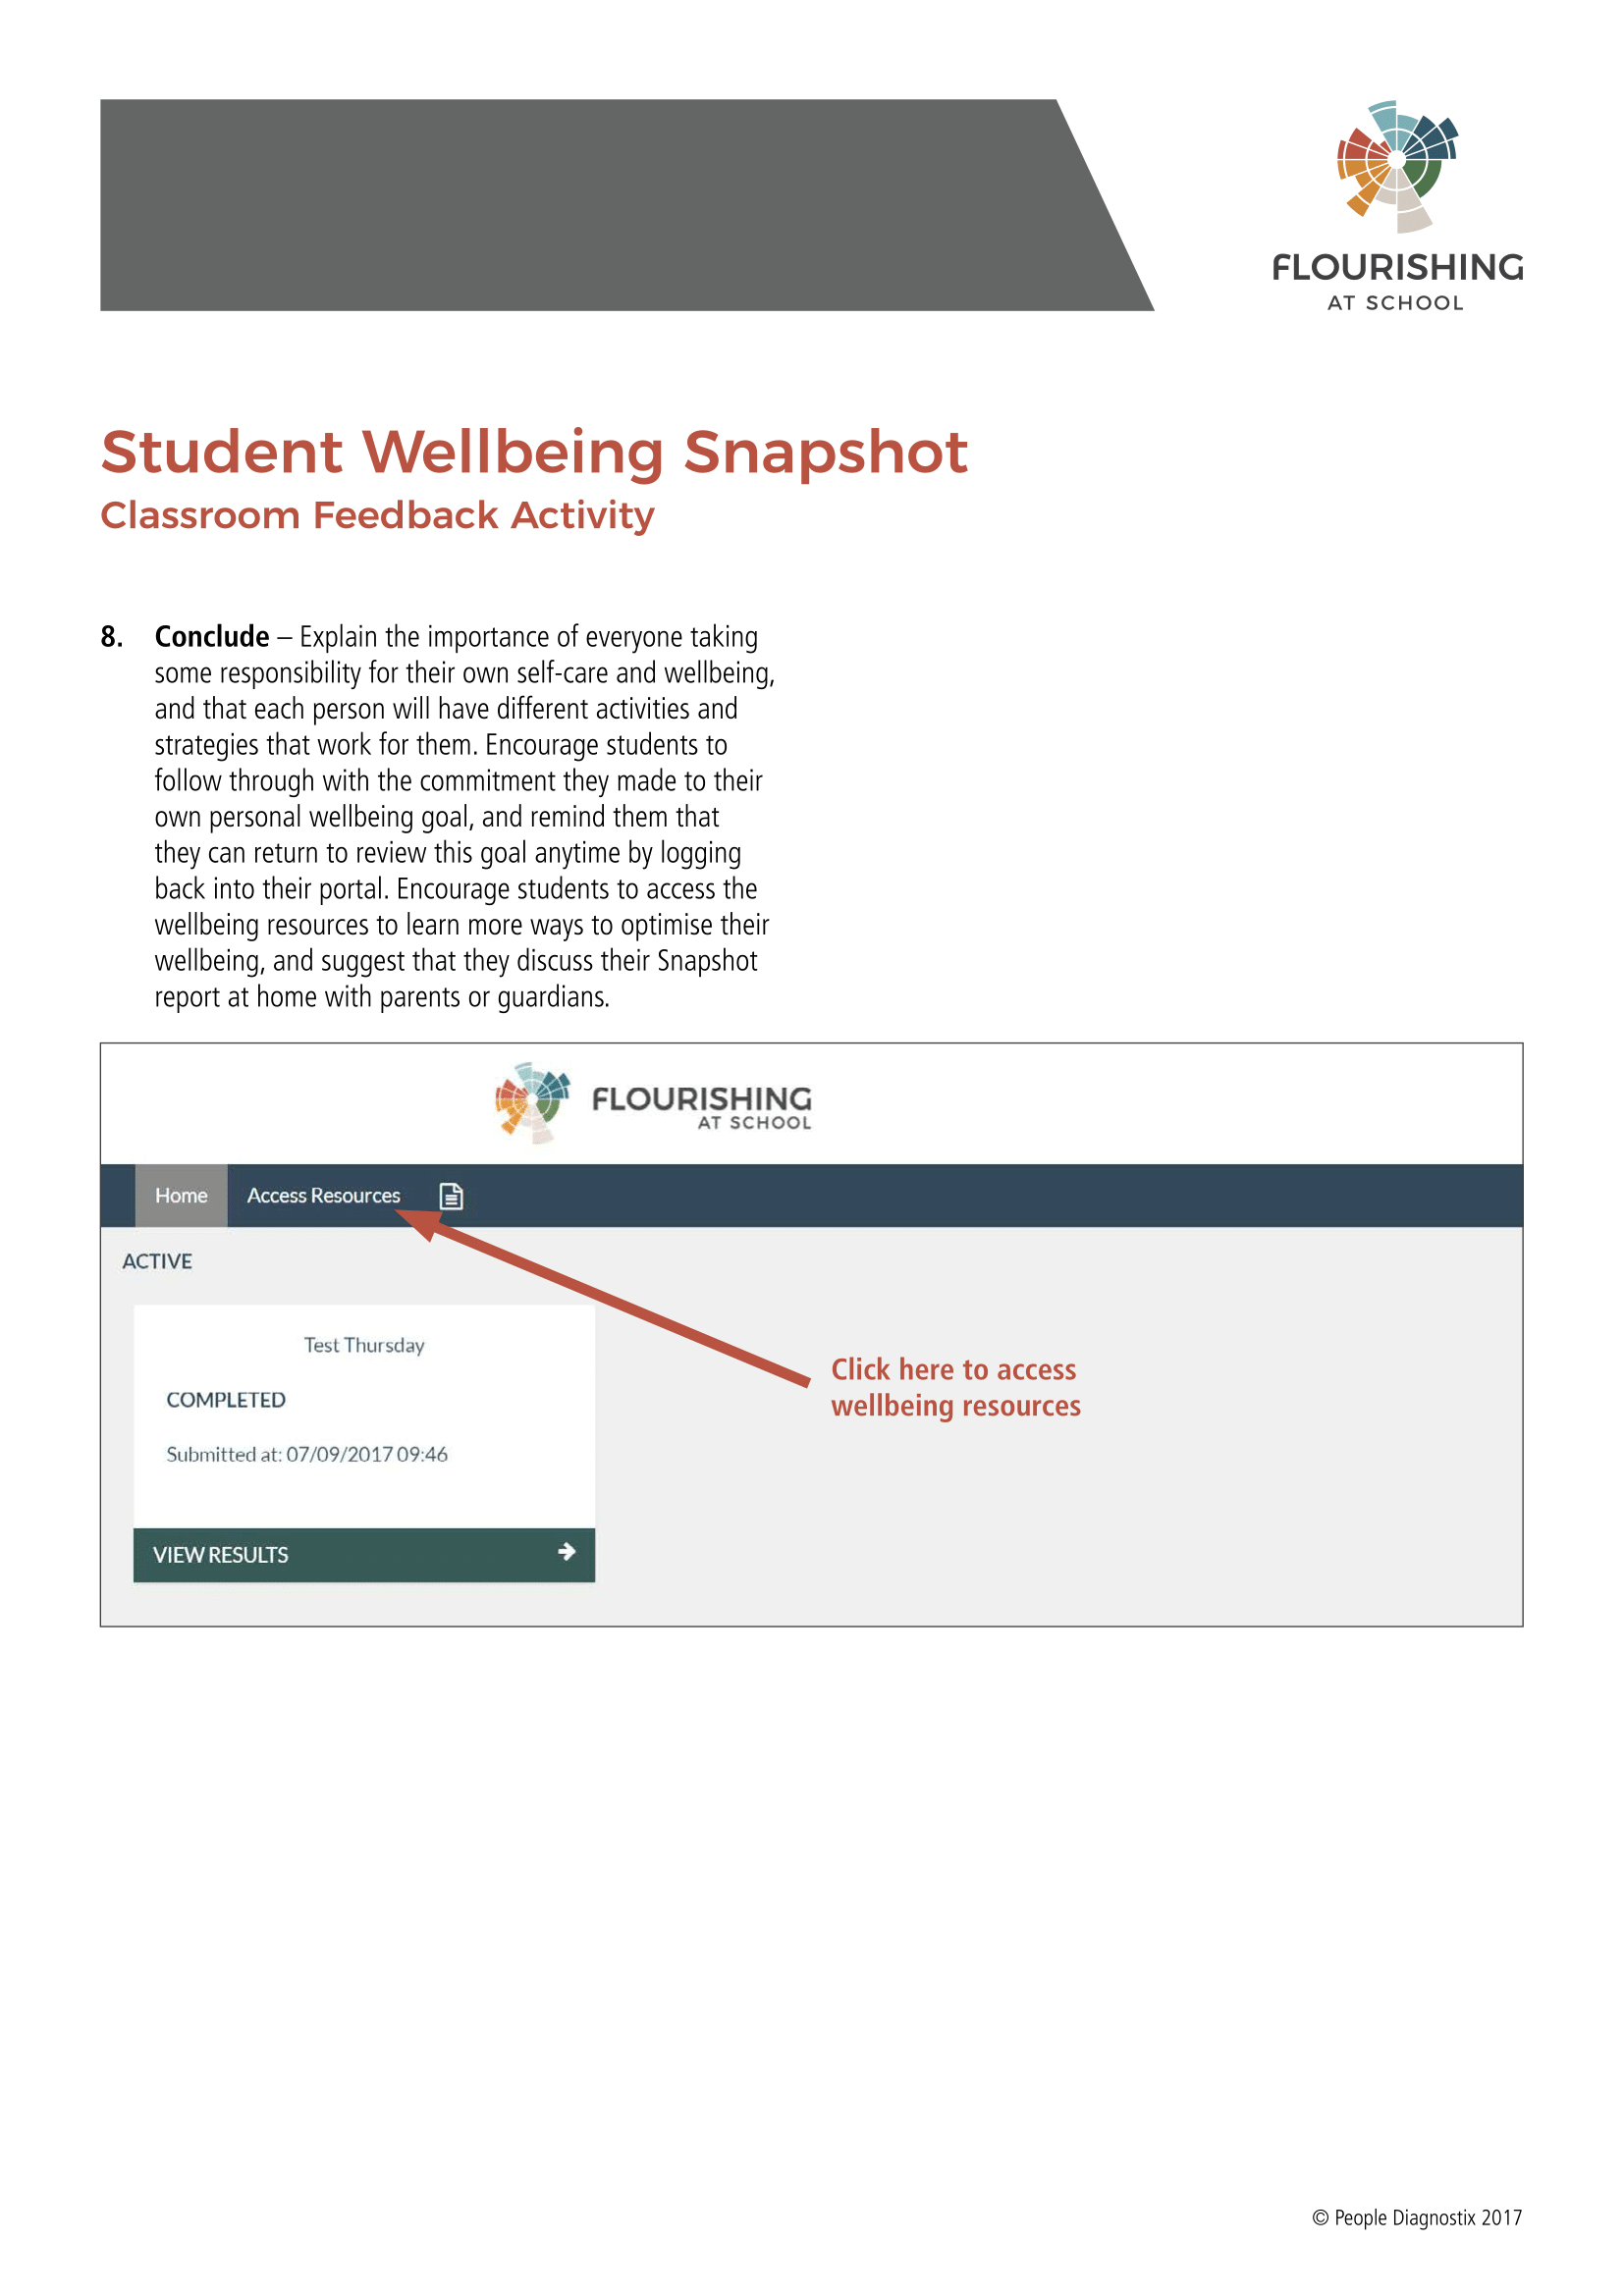
Group feedback

Slide 10
Feedback video
Short videos that can be shown in class to students can reduce problems associated with staff not being trained up/comfortable explaining interpretation of feedback reports
These can also be shared with parents for their education.
FAS feedback video: https://vimeo.com/203786962

Slide 11
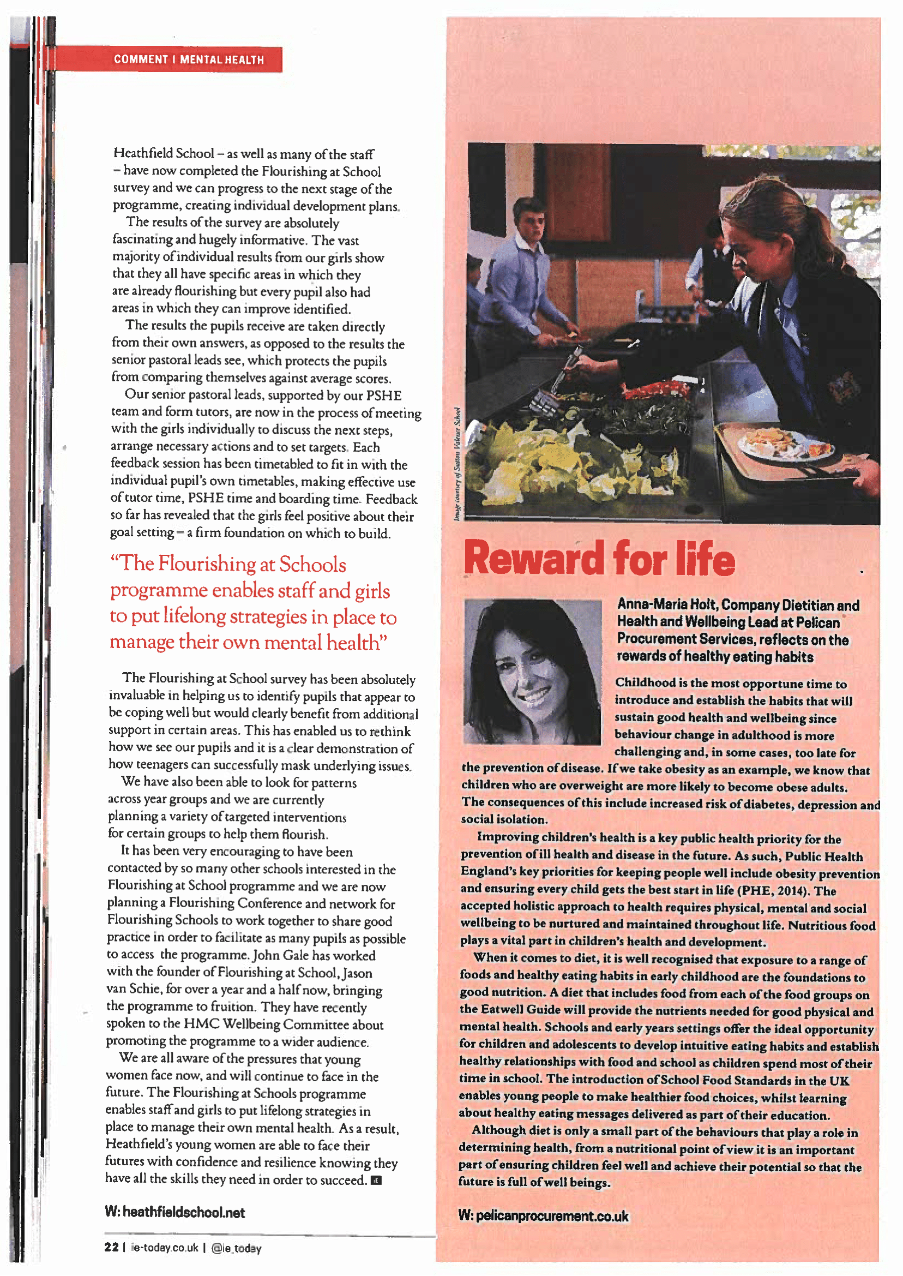
Wellbeing “coaching”
https://bit.ly/2O6t8DZ

Slide 12
Summary of tips
Don’t measure what you don’t want to provide feedback on
Provide feedback as soon as possible following survey
Provide resources for understanding and improving wellbeing
Link results to action steps/goals to help individuals be more likely to apply wellbeing strategies
Offer students the opportunity to talk to a “wellbeing representative” (school psychologist/teacher) to discuss in more detail if required
Provide information to parents about what is measured and how feedback is to be given

Slide 13
Enquiries
People Diagnostix
Enterprise Unit 3, Suite 4
9 De Laeter Way
Bentley, WA 6102
1300 739 426
reception@peoplediagnostix.com.au
www.flourishingatschool.com

