Slide 1
Flourishing Through Failure
How Positive Education informs best-teaching practice - Developing Growth Mindset through explicit and implicit teaching.
Steph Langley and Shelley Martin
Wellbeing Co-ordinators All Hallows’ School
www.PESA.edu.au © PESA 2018

Slide 2
Workshop Objectives
Understand why students prone to perfectionism often avoid taking risks due to a fear of failure. An introduction to context.
Understand how to use explicit and implicit practice to support students in changing mindset.
Gain insight into classroom practice that seeks to highlight and embrace failure as an opportunity for learning.
www.PESA.edu.au © PESA 2018

Slide 3
School Values
Respect
Compassion
Integrity
Justice
Joy
Service
All Hallows’ School
All Girls School
1550 Students
Steeped in Mercy Tradition
Academic values are based on assessment and subsequently performance.
www.PESA.edu.au © PESA 2018

Slide 4
Teaching Practice
Explicit
Focus on progress
Understanding the process of learning
Implicit
Understanding of current teaching practice values
Focus on individual student progress
www.PESA.edu.au © PESA 2018

Slide 5
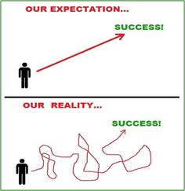
Explicit Teaching – Understanding the Learning Process
www.PESA.edu.au © PESA 2018

Slide 6
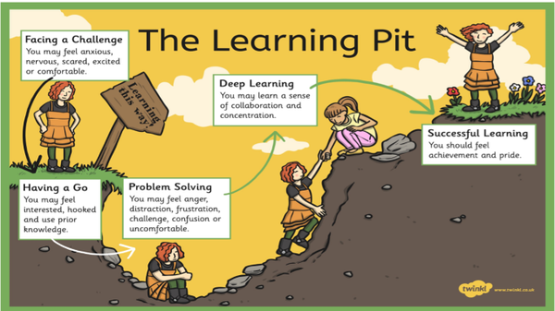
Strategy: The Learning Pit
www.PESA.edu.au © PESA 2018

Slide 7
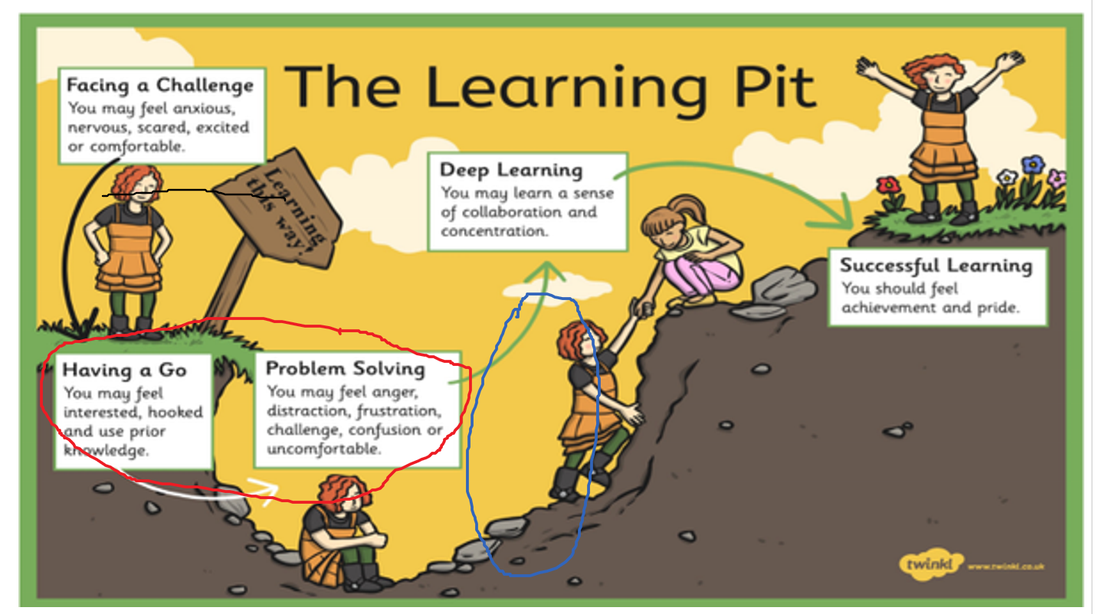
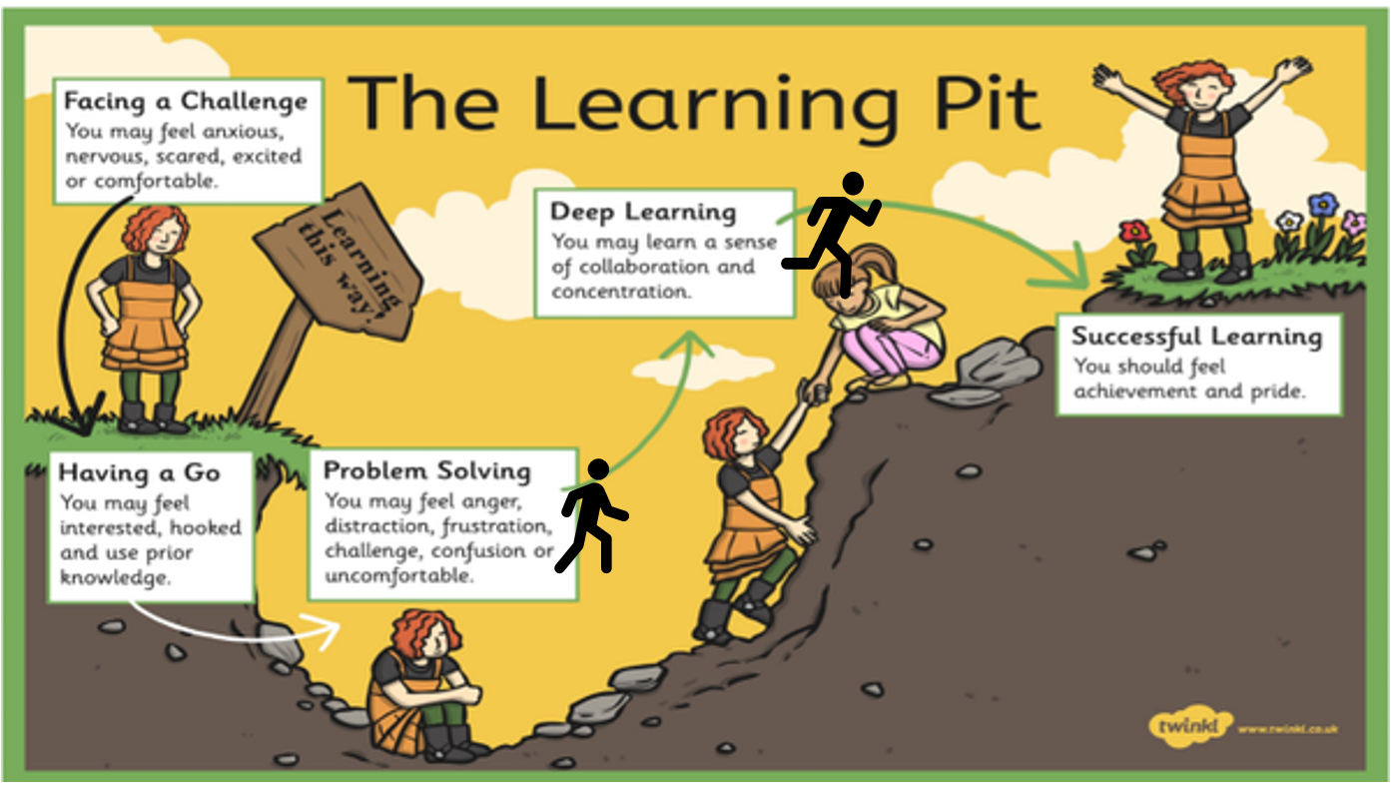
Examples- The Learning Pit in Action – Year 11 Accounting
“I put myself a little further forward of the learning pit as last week. I believe I was in the pit but I definitely feel I am moving forward and beginning to understand more now that I have wrapped my head around the content.”
“I feel I am in the learning pit, stuck between having a go and problem solving. This is because I have never done accounting before and I don’t know all the new terms and rules very well yet. I am interested to learn more and gain knowledge but at the same time stressed and confused.”
“I have placed myself here because yesterday I was very confused and didn’t have a clear understanding of what to do. When I did my homework and kept working I slowly started to understand and I think if I continue to work hard and keep persevering I will slowly get out of this pit.”
www.PESA.edu.au © PESA 2018

Slide 8
Examples- The Learning Pit in Action – Year 11 Accounting
“If I try and make more time to focus more on the homework and study more on the types of accounts and the equations.
Get my brother to tutor me on things I am confused about.”
ACTION PLANS
“To help myself out of the pit I plan to look individually at each concept and work to understand its purpose and why it is used. I can also look over and complete all activities, making sure to check my answers and, understand the ones I got wrong.”
www.PESA.edu.au © PESA 2018

Slide 9
Implicit Teaching – Understanding of current teaching practice and values
What role does assessment play in your classroom?
Think- Pair-Share
www.PESA.edu.au © PESA 2018

Slide 10
Discussion
www.PESA.edu.au © PESA 2018

Slide 11
Contact Information
Steph Langley
Wellbeing Co-ordinator
All Hallows’ School
Stephanie.Langley@ahs.qld.edu.au
Shelley Martin
Wellbeing Co-ordinator
All Hallows’ School
Shelley.Martin@ahs.qld.edu.au
www.PESA.edu.au © PESA 2018

Slide 12
Resources of interest
https://www.youtube.com/watch?v=MFzDaBzBlL0 – Neuroscience, The Backwards Bicycle
https://www.youtube.com/watch?v=3IMUAOhuO78 – The Learning Pit, James Nottingham
https://www.challenginglearning.com/learning-pit/ - The Learning Challenge, James Nottingham
https://www.challenginglearning.com/resources/resource-category/4720/ - The Learning Challenge, Resources
https://www.kqed.org/mindshift/50485/how-empowering-girls-to-confront-conflict-and-buck-perfection-helps-their-well-being- - Mind Shift Article: How empowering girls to confront and buck perfection helps their wellbeing.
https://www.educationworld.com/a_curr/shore/shore008.shtml – Article: Education World- Helping the Perfectionist – Dr Ken Shore
https://internationaljournalofwellbeing.org/index.php/ijow/article/view/588/635 - Journal Article: Positive Education: Learning and teaching for wellbeing and academic mastery – Mathew White and Margaret Kern
www.PESA.edu.au © PESA 2018

